Slide 1
2018: What’s Ahead for Regions
Florida Association of Regional Councils January 12, 2018
Presented by:
Leslie Wollack, Executive Director National Association of Regional Councils

Slide 2
About NARC
Membership organization in Washington, DC
Created by the National League of Cities and National Association of Counties in 1968 as the National Service to Regional Councils
Members include: councils of government, metropolitan planning organizations (MPOs), planning commissions, other regional entities
Work on a wide range of issues including: transportation, aging, housing, brownfields, economic development and beyond
Looking forward to celebrating our 50th anniversary in Orlando

Slide 3
Infrastructure Package
Various reports indicate a very wide variety of infrastructure including: airports/air traffic, bridges, highways and roads, transit, ports, waterways, high-speed internet and telecommunications, freight railroads, pipelines, dams, levees, water and wastewater facilities, electricity transmission and even schools, veterans facilities, hospitals
The Administration is sending mixed messages on the next steps and timeline causing uncertainty in the entire sector
Concern that additional local funding financed by cuts in other programs
Advocates hoped that transportation funding would be included in tax bill
Leveraged investment: $1 trillion
P3s & “asset recycling”
Streamlining of rules and regulations

Slide 4
Rural Transportation
RTPOs work mostly through the state department of transportation
Conduct planning activities for rural regions (less than 50,000 population)
No federally required responsibilities
Support statewide planning requirements and provide technical assistance to local governments on transportation issues
Valuable for their ability to look comprehensively at regional programs
How will technology – automated vehicles – change the landscape to improve rural mobility
Rural broadband

Slide 5
Disaster Assistance
The federal government has approved two bills to provide relief for the 2017 hurricanes and wildfire disasters:
September: $15.3 billion disaster aid package passed by Congress (HR 601)
October: $36.5 billion disaster aid package that also bailed out the National Flood Insurance Program (HR 2266)
The Trump Administration sent an additional $44 billion disaster assistance request to Congress in November
Congress is now considering attaching additional disaster assistance to a federal budget deal, which must be made before the January 19th deadline

Slide 6
Tax Reform Impact
Publicly issued Tax Exempt Municipal Bonds continue to be safe
Local leaders helped save Private Activity Bonds (PABs) in final bill
Advance refunding bonds lose their preferential tax treatment
State and Local Tax Deduction (SALT) continues to be restricted
Key tax credits survive with some restrictions:
Historic Tax Credit (HTC)
New Markets Tax Credit (NMTC)
Low-Income Housing Tax Credits (LIHTC)
Preemption and declining federal investment in communities, tax bill takes away important local tools
IRS will decide about implementation and ability to prepay 2018 local taxes

Slide 7
Fair Housing Rule Delay
HUD delays Implementation of the Affirmatively Furthering Fair Housing Rule
Requirement for local governments to complete assessment of Fair Housing for CDBG, HOME and Emergency Solutions Grant
Some concerned the new HUD criteria and assessment tool for developing fair housing goals burdensome and new funding necessary to implement
New rule provides more time for program grantees
Grantees with an AFH must continue
Those grantees in process can continue or revert to prior Analysis of Implements process

Slide 8
2018 Farm Bill
Bill reauthorization deadline: September 30, 2018
Expected release of draft bills:
House version: late January/early February 2018
Senate version: Spring 2018
Early Points of Concern in the Farm Bill:
SNAP: We may see a reduction in funding or see it removed entirely from the bill to be considered separately
Conservation programs and innovative programs without baselines may be targeted for cuts/elimination
Timing: If Congress doesn’t consider the bill by July 2018, it’s likely they will wait until after midterms are over to pass it

Slide 9
Census 2020
Planning for the 2020 Census is already well underway
The 2020 Census will determine the distribution of $6 trillion in federal assistance over the next 10 years
An accurate count will lead to more informed decisions on the local level
Current political challenges:
DOC requested an additional $187 million for FY 2018 and an additional $3.3 billion through 2020 for the decennial Census
Congress directed Census Bureau not to spend more on 2020 Census than they did on the 2010 Census
DOJ is pushing Census Bureau to insert a question about citizenship status

Slide 10
Water

Slide 11
National Institute of Standards and Technology (NIST): Challenges in Community Resilience
What should the community be resilient to?
How to account for interconnected nature of social systems, buildings, and infrastructure?
How to identify performance gaps (“measure”) resilience?
Hazards
Natural hazards
Technological hazards
Human-caused hazards
Degradation
Hazard Level
Routine
Expected
Extreme
Notes:
Perhaps more than any other area of the country, Florida knows that resilience to hazards of all kinds is a challenge for communities
NARC has made that an important part of our agenda
Here’s a summary that captures some of the key hazards and issues that communities face
This slide comes from the National Institute of Standards and Technology, or NIST – a federal non-regulatory agency that provides some very practical resources that can help you and your communities plan to be more resilient.

Slide 12
NIST: Why Community Resilience?
Communities are socio-technical systems
Buildings and infrastructure enable social and economic function
Social and economic needs and functions should drive the goals for performance of buildings and physical infrastructure
All communities are exposed to hazards that can cause disruption to social and economic activity
Government
Energy
Transportation
Citizens
Functional
Requirements
Structures
Industry
Business
Water
Notes:
NIST recommends viewing buildings and the physical infrastructure systems that communities depend upon more broadly -- as vital parts of systems that enable and support social and economic needs and functions
By considering the community as a system and understanding its priorities and dependencies, it is possible to establish performance goals for buildings and infrastructure for times when hazards occur that allow the community recover resiliently.
Resilience planning provides a means to integrate community goals and plans

Slide 13
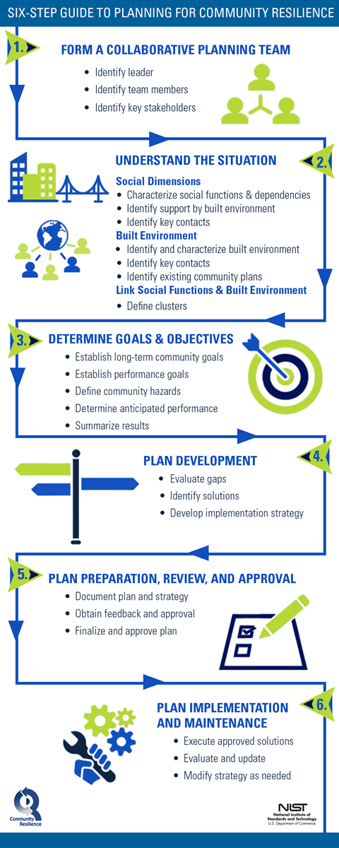
NIST: Planning Steps for Community Resilience
Notes:
Working with communities and technical experts across the country, they’ve come up with a Planning Guide that is now beginning to be used by communities to improve their resilience.
It’s based on a straightforward 6-step process shown here
The Guide contains a wealth of information about buildings and infrastructure systems including communications, transportation, energy, water and wastewater.

Slide 14
NIST: Economic Decision Guide Software (EDGe$) Tool
Easy-to-use online tool to assist decision makers in making resilience planning choices
Tool is a companion to the Community Resilience Planning Guide
Allows the user to conduct a cost-benefit analysis that includes both resilience benefits and day-to-day economic and non-economic benefits.
Notes:
They’ve also just released a downloadable, software-based tool for selecting cost-effective community resilience projects.
The tool, and the methodology it is based on, recognize that many investment decisions will need to meet multiple objectives, with resilience being one.
The tool allows the user to evaluate the costs, resilience benefits (e.g., losses avoided) as well as other economic benefits (e.g., reduced traffic congestion) and non-economic benefits (recreation space, connecting neighborhoods) of candidate projects.
The tool can be used by itself but is intended as a companion to the Community Resilience Planning Guide to support evaluation of candidate projects to improve resilience.

Slide 15
NIST Contact Information
Website:
https://www.nist.gov/topics/community-resilience
Guide:
https://www.nist.gov/topics/community-resilience/community-resilience-planning-guide
Or google “NIST Resilience Planning Guide”
General E-mail: resilience@nist.gov
Notes:
Here’s how you can get more information about the Guide, the software tool, and who to contact at NIST for more information

Slide 16
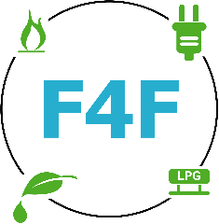
Fleets for the Future Goals
Aggregate demand for propane, electric, and CNG vehicles and infrastructure
Reduce the cost for fleets
Develop resources such as best practices
Catalog lessons learned

Slide 17
Two Parallel Efforts Under F4F
National procurement
Selected an established buying cooperative to pilot test these concepts
Any public fleet in the country can join
Partners: National Joint Powers Alliance
Regional procurements
Local RPCs and COGs develop their own contracts, tailored to regional stakeholder input
Procurements mainly open to local public fleets
Partners: MARC, NCTCOG, MAPC, MWCOG, PAG

Slide 18
Learn more about F4F
Learn more about how your region can participate!
Website: http://www.fleetsforthefuture.org/
Twitter: @Fleets4future
NARC Staff Contact: Sarah Reed – sarah@narc.org

Slide 19
Trees and Stormwater Grant
TreesandStormwater.org
Funded by the U.S. Forest Service, created in partnership with Ohio-Kentucky-Indiana Council of Governments, Davey Resource Group, and Centerline Strategy, LLC.
Web-based guide for communities interested in incorporating trees
into stormwater management plans and policies
Developed by forestry and stormwater professionals with oversight
from a national advisory committee
Comprehensive resource library containing over 300 resources, including case studies, tools, calculators, maps, and best practices
Notes:
Document builder section allows users to produce a persuasive document tailored to their specific community designed to make the case for using trees to help manage stormwater

Slide 20
Thank you!
Leslie Wollack Executive Director leslie@narc.org 202-618-5696

