Slide 1
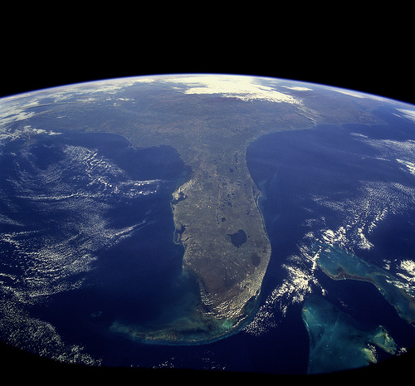
So, how does it end?
Planning from the Future:
Florida2030.org
Tony Carvajal
EVP, Florida Chamber Foundation
TCarvajal@FLFoundation.org
850.521.1258
John Kaliski Cambridge Systematics, Inc. jkaliski@camsys.com 617-301-2493
Notes:
That Used to Be Us
Thomas Friedman & Michael Mandelbaum

Slide 2
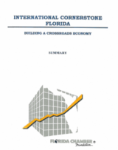
Blueprint for Florida’s Future
2017 – Florida Jobs 2030
2016 – From Excuses to Excellence
2016 – Strategic Look at Medical Tourism
2013 – Florida Trade and Logistics Study 2.0
2011 – Immigration and Florida’s Economy
2010 – Florida Trade and Logistics Study
2010 – Closing the Talent Gap
2007 – New Cornerstone Revisited
2006 – Florida Summit on Affordable Living
2003 – New Cornerstone: Foundations for Florida’s 21st Century Economy
1999 – Transportation Cornerstone Florida
1997 – International Cornerstone Florida
1994 – No More Excuses: What Business
Must Do To Improve Florida’s Schools
1991 – Enterprise Florida: Partnership for a Competitive Economy
1990 – Crossroads: Designing Florida’s Tax Structure
1989 – Enterprise Florida: Growing the Future
1989 – Cornerstone: Foundations for Economic Leadership
1986 – The Role of Privatization in Florida’s Growth

Slide 3
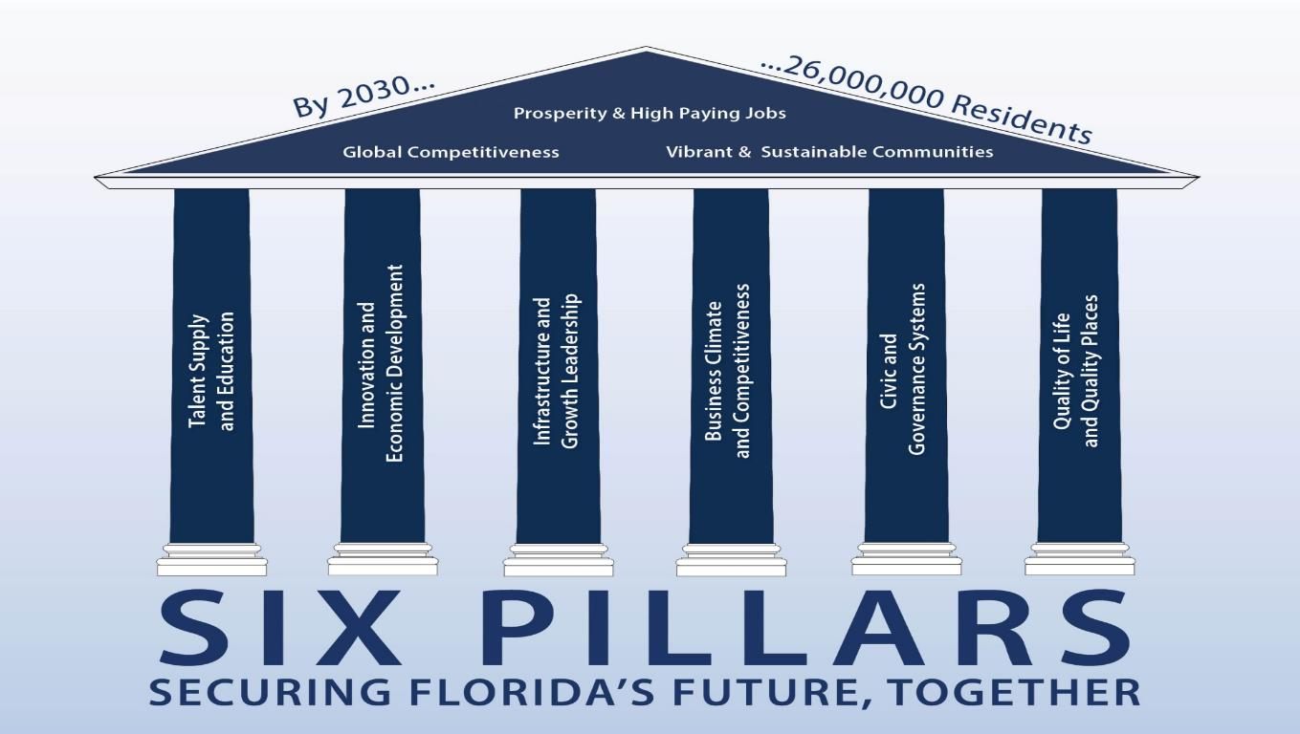
One Voice
“We must plan better for the next 6 million Floridians
than we did for the last
6 million”
Notes:
Key question – how do we prepare for 6 million more Floridians by the year 2030?
Will use 6 Pillar framework – but focus on how to support three outcomes
Global leadership
Prosperity and high paying jobs
Vibrant and sustainable communities

Slide 4
3 Years
6 Pillars
10,000+ Floridians
1 Plan
Florida2030.org
Notes:
This is a 3 year process to engage more than 10,000 Floridians to create a strategic plan for the state

Slide 5
Globally Competitive?
Florida’s economy is 16th largest in the world today
#25 in 2030?
#10 in 2030?
Florida
#16
Source: World Bank, 2015

Slide 6
Prosperity for All?
Global Income Inequality Index
Florida
U.S.
More Equal
Less Equal
Source: American Community Survey | World Bank Indicators
Notes:
One of the key question is where we can create a path to prosperity for all Floridians.
We are experiencing increasing gaps in income an opportunity across the state. Looking at the gaps in come between the highest and lowest earners in the state, Florida has significantly more disparity than the US as a whole.

Slide 7
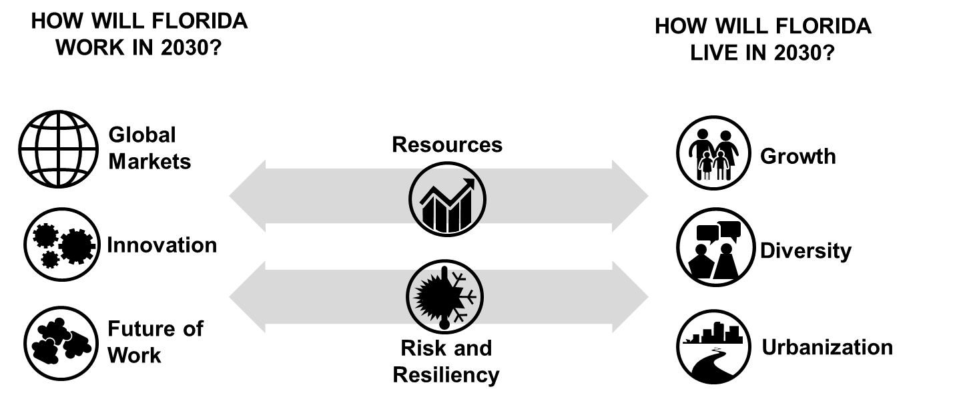
Drivers of the Future

Slide 8
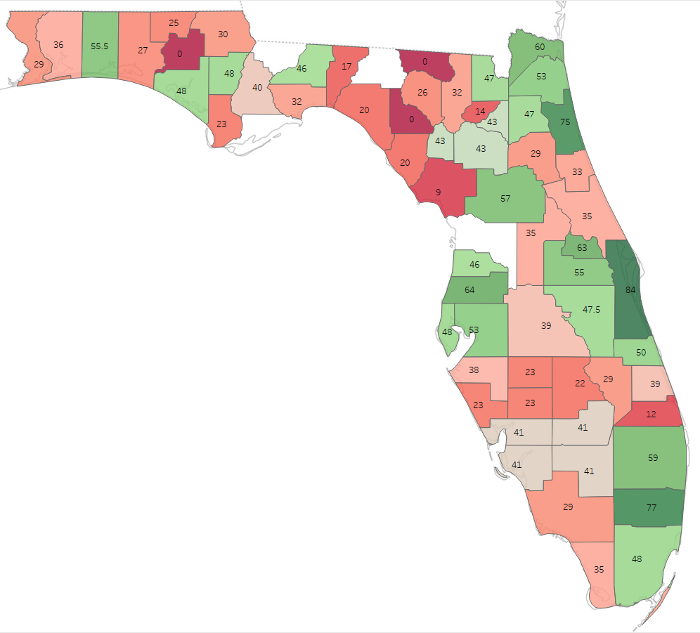
While
87%
Optimistic
Question: Positioned for
Global Competitiveness,
Prosperity AND
Vibrant & Sustainable Communities?
Key Reasons:
Growth
Diversity
Natural Resources
Weather
No Income Tax
Most Say
“NO”
as of September 2017
Notes:
First of several slides showing town hall input; as of 6/8/17. Note that counties that are blank are those in which data are still being processed.
Question: are you optimistic about Florida’s future?
87% responded yes
Darker green is more optimistic
Only one county- Indian River, had less than 50% optimistic
Key reasons cited for optimism: growth, diversity, natural resources, weather, lack of income tax

Slide 9
What’s Trending?
Public Safety
Arts, Culture, Heritage & Sense of Place
Strength
Health & Wellness
Water Infrastructure
Business Climate- Regulations
Economic Development
Responsiveness of Govt
Weakness
Talent
Transportation
Economic Prosperity
Affordability of Housing
Getting Worse
Improving
*Preliminary Analysis, as of 9/2017

Slide 10
Key Themes
Talent magnet
Value-added / innovation economy
Global hub
21st century connectivity
Placemaking
Agility & resiliency
Repositioning Florida
Paths to prosperity
Ecosystems approach

Slide 11
“C Suite” Confidential Interviews on
Florida’s competitiveness & future opportunities
A research initiative for
Notes:
All but one interview believes we are headed in “Right Direction” and universal support/credit for Governor Scott
High levels of business optimism out there
Favorable attitude toward workforce, though concern for availability of skilled trades (Construction) and mid-skills
Businesses are very pleased with colleges and universities, especially positive about accountability metrics
“legal hell hole” and high trial lawyer influence
Transportation matters and must keep investing, including help with transit
Incentives matter but we have more to offer. Challenge is uncertainty, branding and “sour taste” with (mis)handling
Business cares about environment and K-12
Business community tends to speak with one voice when meeting together but splinters when folks head home
ONE VOICE important to have impact with FL2030

Slide 12
Rollout Strategy
QOL
Statewide rollout event
March 8 -- 50 year anniversary
Regional rollouts
Target=6-10
Pillar focus rollouts
One per Pillar
Regional conversations and planning
Business Climate
Notes:
Heavy focus on 2018 rollouts but really multi-year
Need “hosts” (lend your name and make invites) and supporters (help underwrite, encourage partners to participate)

Slide 13
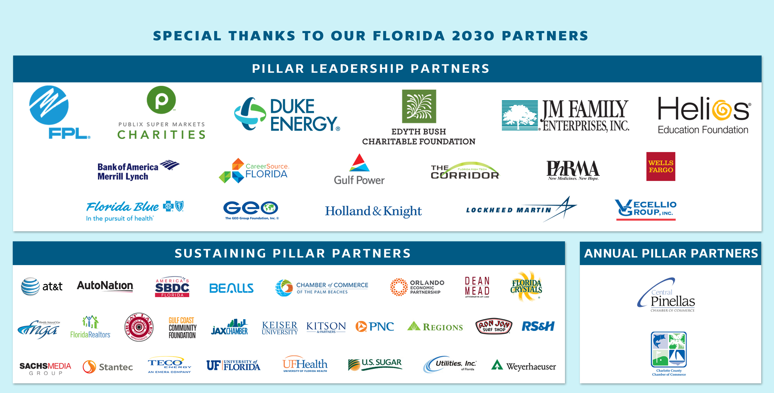

Slide 14
6 Pillars
3 Years
10,000+ Floridians
1 Plan
Florida2030.org
Notes:
This is a 3 year process to engage more than 10,000 Floridians to create a strategic plan for the state

