Slide 1
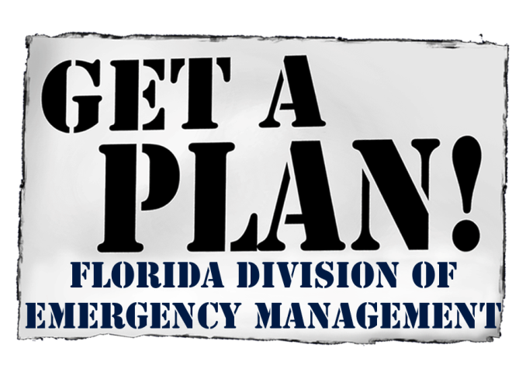
Florida’s Housing RSF FL and the National Disaster Recovery Framework
Christina Rojas-Kasten
February 12, 2016

Slide 2
First Things First…
Bureau Chief Evan Rosenberg apologizes for not being able to be here himself
He would like to come to the next meeting on March 11, to answer questions and talk more about this matter
Ms. Rojas-Kasten is a Coordinator within the Division’s Individual Assistance Section, and she will be presenting a basic informational presentation on my behalf

Slide 3
I – NDRF/RSF Basics

Slide 4
Presentation Overview
Goals & objectives of this presentation:
Present information on the National Disaster Recovery Framework (NDRF), as well as Recovery Support Functions (RSF’s)
Discuss challenges and opportunities at the State level in regard to the Housing RSF
Plant the “seed” of how the Regional Planning Councils can contribute to the development of this RSF

Slide 5
The Federal Framework Timeline

Slide 6
NDRF Main Components
The NDRF document is a recommended read for local and State agencies.
You can download a copy here: https://www.fema.gov/media-library/assets/documents/24647?fromSearch=fromsearch&id=5124
The NDRF brings 2 new concepts to the table:
The concept of Recovery Support Functions (RSF’s)
The concept of a Federal Disaster Recovery Coordinator (FDRC)

Slide 7
Recovery Support Functions
Recovery Support Functions are analogous to our Essential Support Functions that we use in the EOC
But, there are differences:
Functional areas covered
When we activate and for how long
“Concentration” of time & effort

Slide 8
RSF Functional Areas
Community Planning and Capacity Building
Economic
Health and Social Services
Housing
Infrastructure
Natural and Cultural Resources

Slide 9
Federal Coordinating Agencies
Community Planning and Capacity Building: Dept. of Homeland Security/FEMA
Economic: Dept. of Commerce
Health and Social Services: Dept. of Health & Human Services
Housing: HUD
Infrastructure: Dept. of Defense/USACE
Natural and Cultural Resources: Dept. of Interior

Slide 10
Important Points About RSF’s
RSF’s will be activated on a case-by-case basis, depending on the needs of survivors in a given disaster.
The main purpose of the RSF’s is not to bring an influx of cash; that is still the point of the PA, IA and HMGP programs. What the RSF’s do is coordinate technical assistance from FEMA and other federal programs as needs are determined

Slide 11
General State of Things in FL
Right now, FDEM is working with a number of agencies, and coalitions of agencies, to establish RSF’s and lead agencies within those RSF’s
Florida has a very robust ESF structure:
We have 18 ESF’s identified, whereas the federal ESF structure only has 15,
Technically (“legally”), Florida ESF’s are always “on” and ready to serve the citizenry

Slide 12
So Why do we Need RSF’s?
From the previous slide, we can see that we are in pretty good shape in FL, at least structurally, should we have a triggering event tomorrow…
BUT, we may not be set up optimally for the needs of survivors and the community as we move into a long-term recovery
By the time that we activate RSF’s, survivors basic needs are already being met, and we are talking about repairing and re-establishing individual and community-based networks

Slide 13
More than Just Being In-Line with FEMA
If we were to use the existing ESF structure, we would obviously be out-of-phase with the federal structure.
But that is rarely a limiting concern for us here in FL! (once again, note that we have more ESF’s than they do)

Slide 14
The Opportunity
Instead of taking non-optimized structures and cobbling them together as best we can, we have the opportunity at the onset to create the optimal structure for Florida
How do we get there… whenever possible, we use/build coalitions between stakeholder agencies, with local buy-in

Slide 15
The Opportunity (ctd.)
Community Planning and Capacity Building: Dept. of Economic Opportunity
Economic: Department of Economic Opportunity
Health and Social Services:
Health – Department of Health
Social Services – Department of Children and Families
Housing: What we are here to discuss
Infrastructure: TBD (DOT)
Natural and Cultural Resources: TBD (DEP/SHPO)

Slide 16
General Thoughts
We could certainly veer away from the Federal structure… we are all about what is doing what is best for Florida. However, at least at first, at the State level we are going to build a structure to mate up nicely with the Federal side
This does not mean that it will be this way forever. Nor does it mean that all local structures will end up looking like a carbon copy of the State’s structure.

Slide 17
II – Concept of Operations
Some Guiding Principles as we Move Outward

Slide 18
RSF Concept of Operations
At the State level, RSF’s will be established (initially) to mate up with the 6 Federal RSF’s established under the NDRF.
A “Lead Agency” will be established for each Florida RSF, with each “Lead Agency” supplying a designated Point of Contact for the RSF, which will be conspicuously posted on FDEM’s website.
The purpose of RSF’s is to assist in the coordination of the flow of information, services and resources between all levels of government – Federal, State and Local.

Slide 19
CoO (ctd.)
RSF’s may be “activated” by joint Federal-State agreement after a federally declared disaster, or by the FDEM Recovery Chief during a State or Local disaster or emergency (regardless of whether there is a State or Local EO).
RSF “activation” shall not necessarily mean that staff are required to occupy a seat in the State EOC, Federal-State JFO or Local EOC. RSF “activation” shall be taken to mean that appropriate staff are to be made available for Emergency Management duties on an as-needed basis.

Slide 20
CoO (ctd.)
RSF “activation” shall not be taken to imply that all RSF’s need to be activated at one time. The nature of the given disaster or emergency shall govern which RSF’s (or parts of RSF’s) are to be “activated” by the FDEM Recovery Chief.
This Concept of Operations (and any associated structural plans) will be memorialized within the State CEMP Plan, and its associated appendices and annexes, as appropriate.

Slide 21
III – Housing Recovery RSF
Introduction to the Housing Recovery RSF

Slide 22
The RSF’s Goals
The goals of the Housing RSF are to:
Address pre- and post-disaster housing issues,
Coordinate/Facilitate the delivery of federal resources and activities to assist local, State and Tribal governments in the rehabilitation and reconstruction of destroyed and damaged housing, whenever feasible, and
Assist in the development of new accessible, innovative and permanent housing options within the impacted community

Slide 23
Types of Housing RSF “Missions”
Some examples of actual “Missions” that the Housing RSF could be tasked with:
Working with local housing planners to develop inventories of housing resources
Working with local planners to develop zoning and regulatory changes needed to compensate for destroyed housing stock
Working with the Community Planning RSF on all of the challenges needed to implement a “FEMA City”-type mobile home solution

Slide 24
Housing RSF “Missions” (ctd.)
(ctd.):
Working with State financing agencies to redirect CDBG, SHIP and/or (new) Legislatively-created housing funds
Coordinating housing Direct Federal Assistance (DFA) missions with FEMA
Coordinating FEMA and Voluntary Agency roof tarping and electric box repair missions
Etc…

Slide 25
The Problem…
Florida does not have a State-level Department of Housing!
Housing in FL has long been seen primarily as a local issue

Slide 26
Synergies Point to a Solution…
But we do have agencies and quasi-agencies that we may be able to cobble together for a multifaceted solution…
FDEM
Assets – Experts on working with survivors & impacted governments
Challenges – No funds to disburse, Lacks trained staff to mobilize on housing issues

Slide 27
Pointing to A Solution… (ctd.)
(ctd.)
Florida Housing Finance Corporation
Assets – Controls funding sources
Challenges – Lacks staff with EM expertise, Staff size is a limiting factor in any case
Regional Planning Councils
Assets – Staff with expertise in housing issues
Challenges – Likely will need to pay for services

Slide 28
The Proposed Solution
Under this first proposal, the Housing RSF structure would look something like:
FDEM – lead agency
Florida Housing Finance Corp. – SME’s for financial-based solutions
Regional Planning Councils – SME’s for planning-based solutions
No commitments now; we are just exploring a potential structure for the time being

Slide 29
IV - Conclusion
Wrapping Up…

Slide 30
Thank You for Your Time!
Mr. Rosenberg would like to come to the March 11 meeting to address any questions you might have

