Slide 1

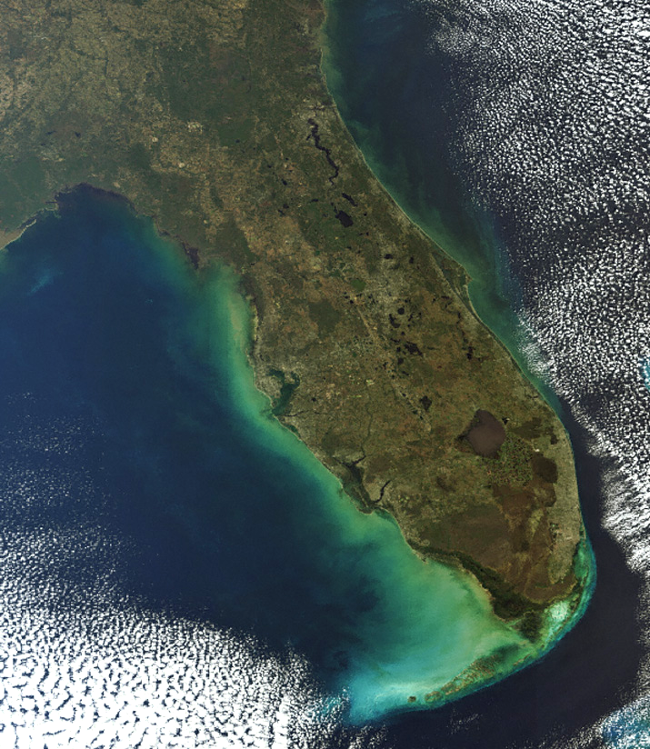
COASTAL FLOOD
RESILIENCY
South Florida initiatives
Keren prize bolter, Phd
Policy & Geospatial Analyst
SOUTH FLORIDA REGIONAL COUNCIL
fRCA Partners meeting
August 19, 2016

Slide 2
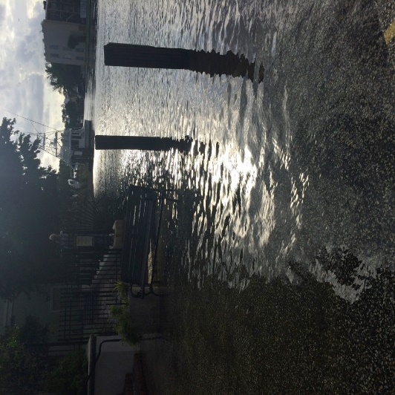
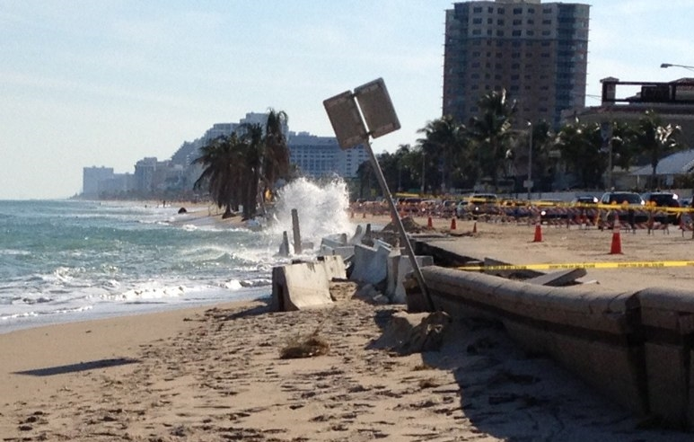
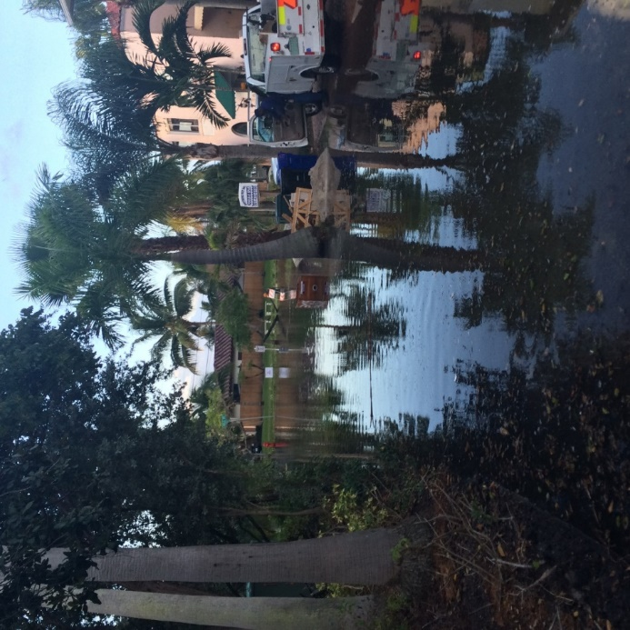
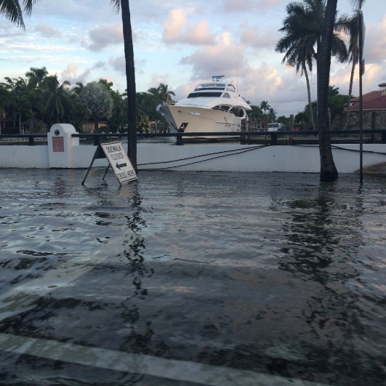
Current & future impacts
Tidal Flooding
Saltwater Intrusion
Failing Drainage
Malfunctioning Canals
Beach Erosion
Habitat loss
Reduced Groundwater Storage

Slide 3







Slide 4
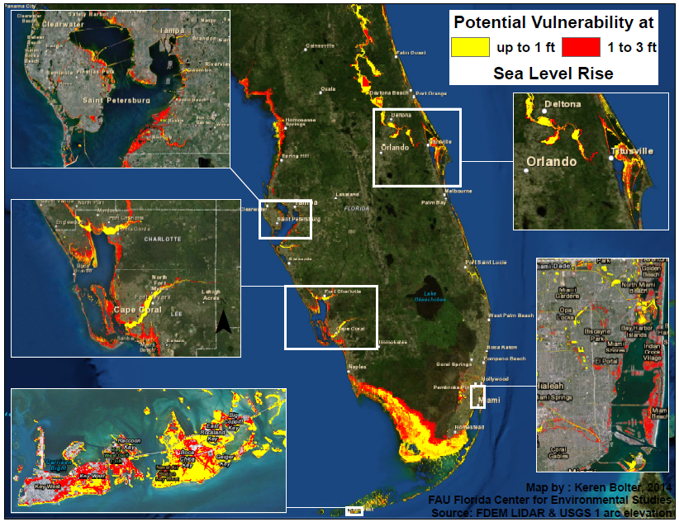
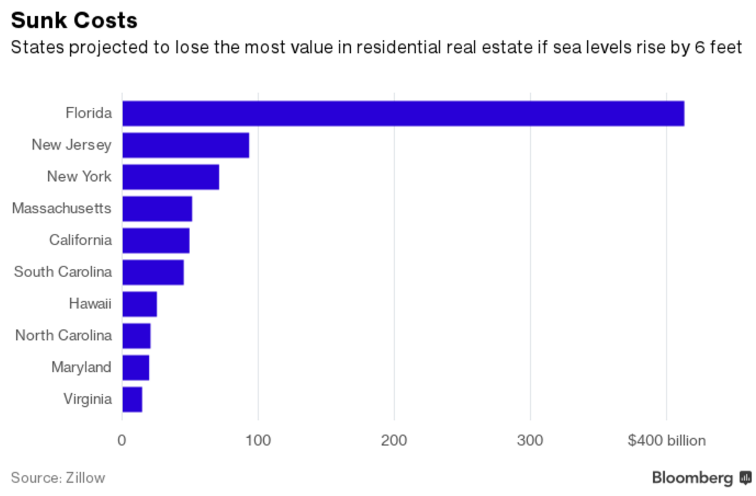
  Florida’s
  Risk:
  New Zillow Report

Slide 5
Coastal resiliency projects
PARTNERSHIPS!
  Compact Initiatives
  County/municipal Work
  Community organizations
  Academic
SFRC Work
  Adaptation Action Areas
  Train the Trainers
  Impacts of SLR on Public Health
  DEO TA for Infrastructure Resilience

Slide 6
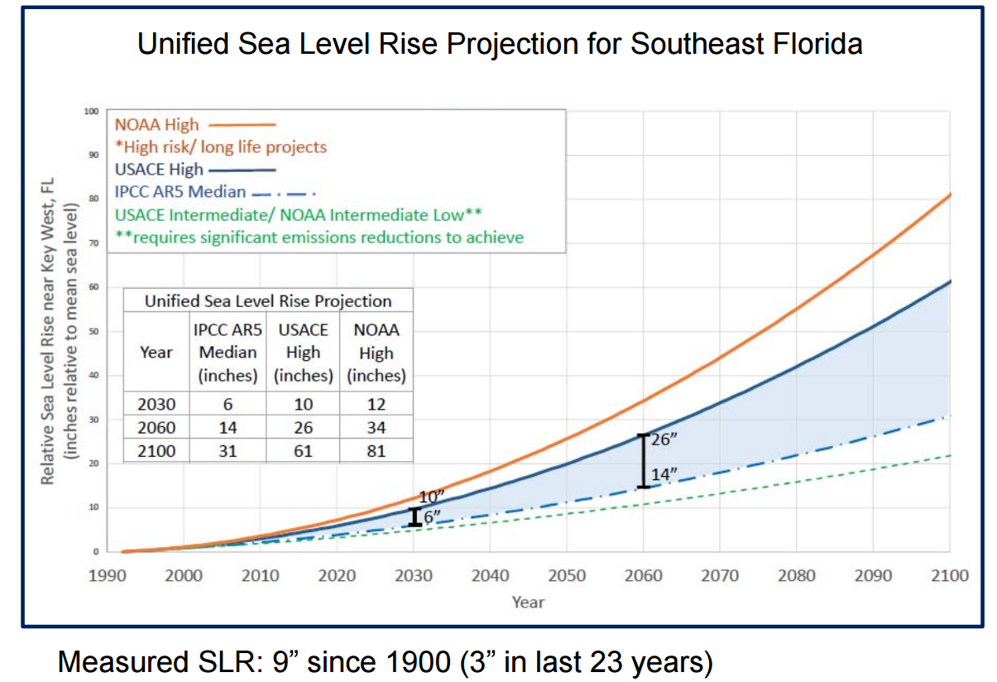
Compact Initiatives : Future projections

Slide 7
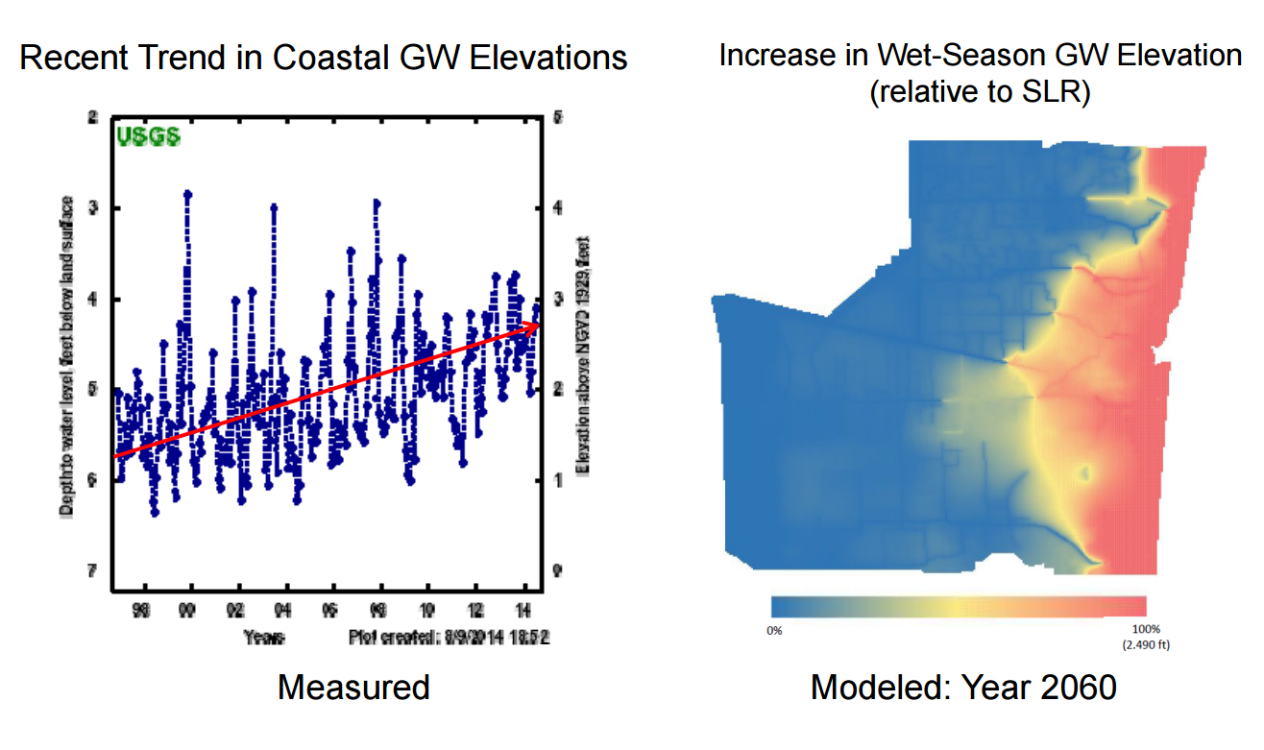
Compact Initiatives : Future projections

Slide 8

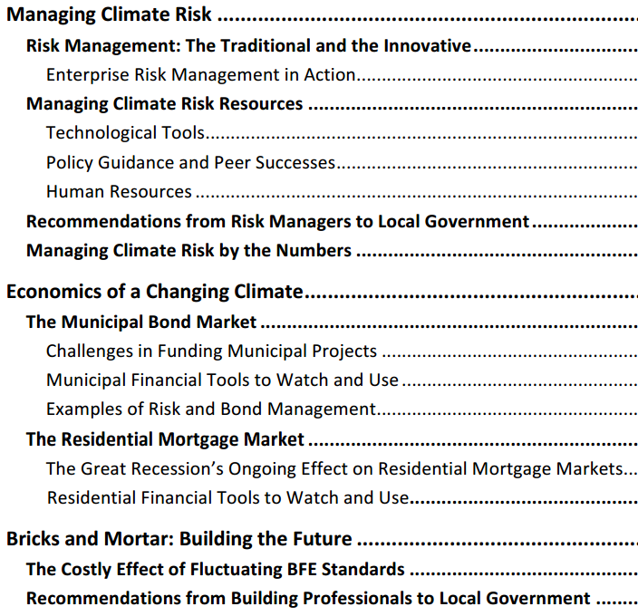
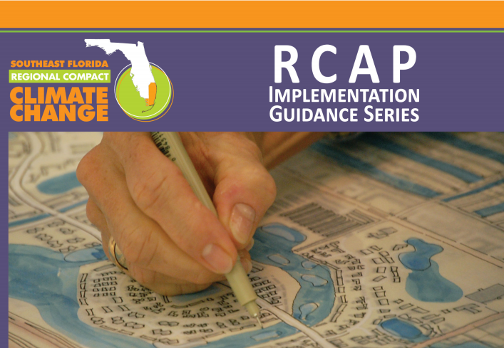
Working groups and business outreach
Reducing Climate Risk and Creating Economic Opportunity
http://www.southeastfloridaclimatecompact.org/wp-content/uploads/2016/04/CompactResourceDocWksp9Final.pdf

Slide 9
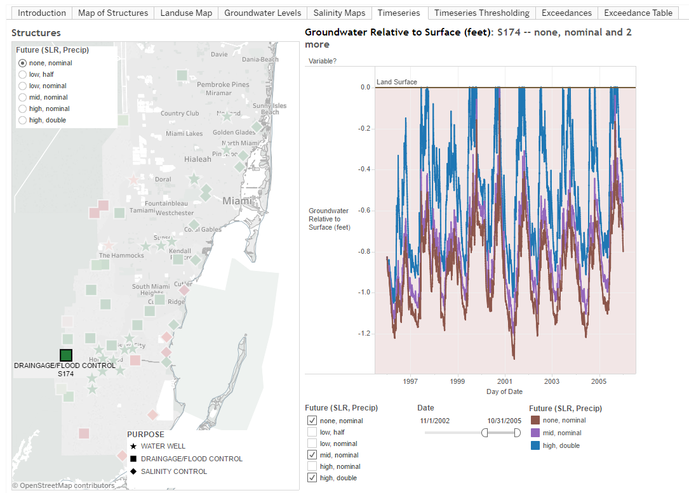
RAND
http://www.rand.org/topics
/community-resilience.html

Slide 10
Resilient redesign workshops
Invited Experts
Kingdom of Netherlands
Florida Climate Institute
3-day design workshops
Transferable models of resilience for South Florida

Slide 11
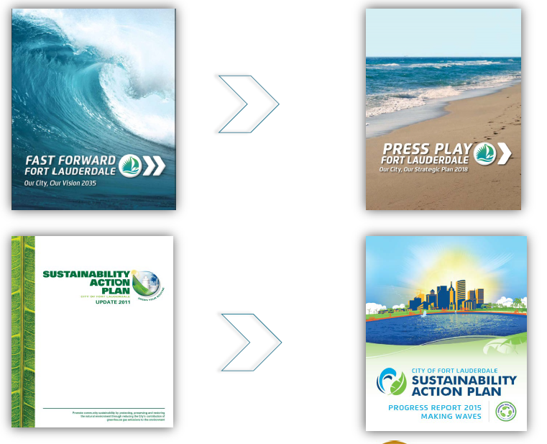
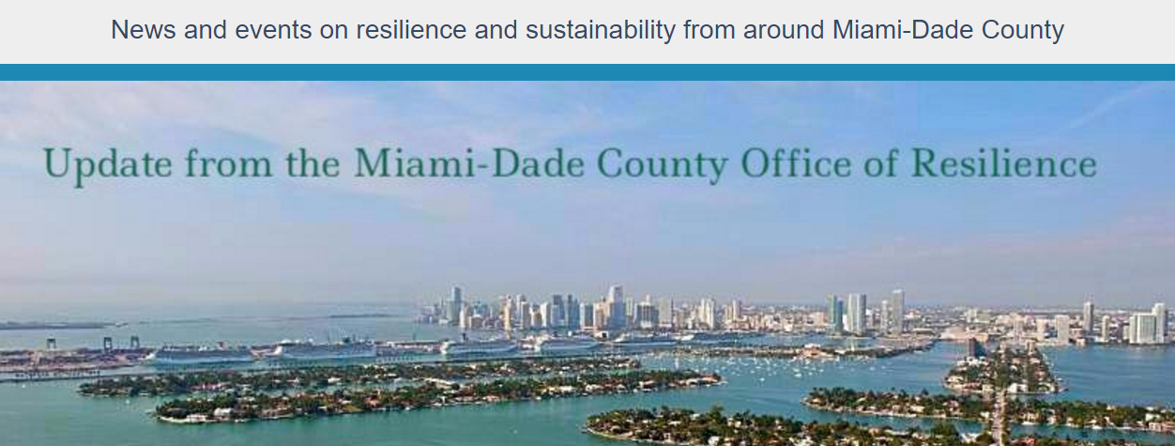

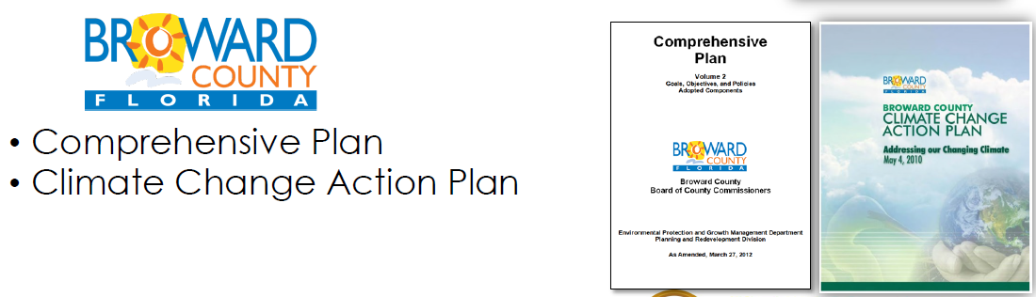
County/municipal Work

Slide 12


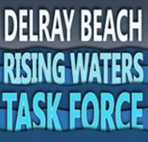

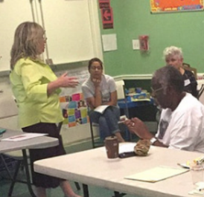
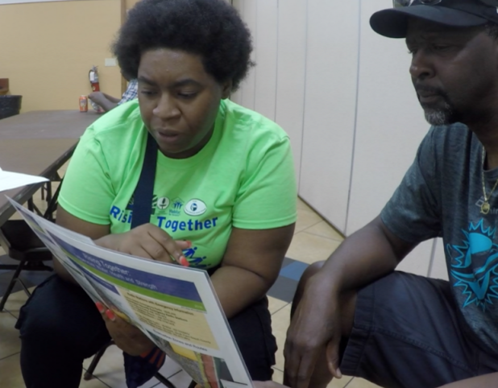
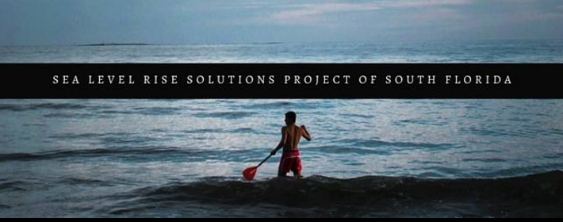
Community organizations

Slide 13


FIU SLR Solution Center
FAU CES climate.miami.edu/

Slide 14
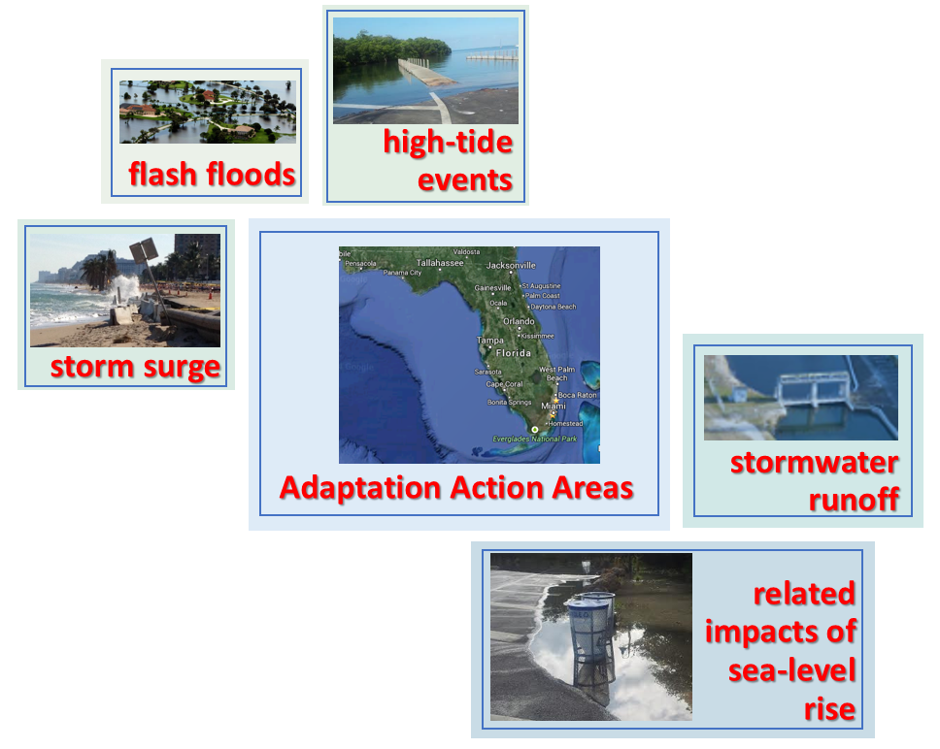
Local Planning Tools – Adaptation Action Areas
Strategies for Adaptation Action Areas may include
Protection
Accommodation
Managed retreat
Avoidance
Other options

Slide 15
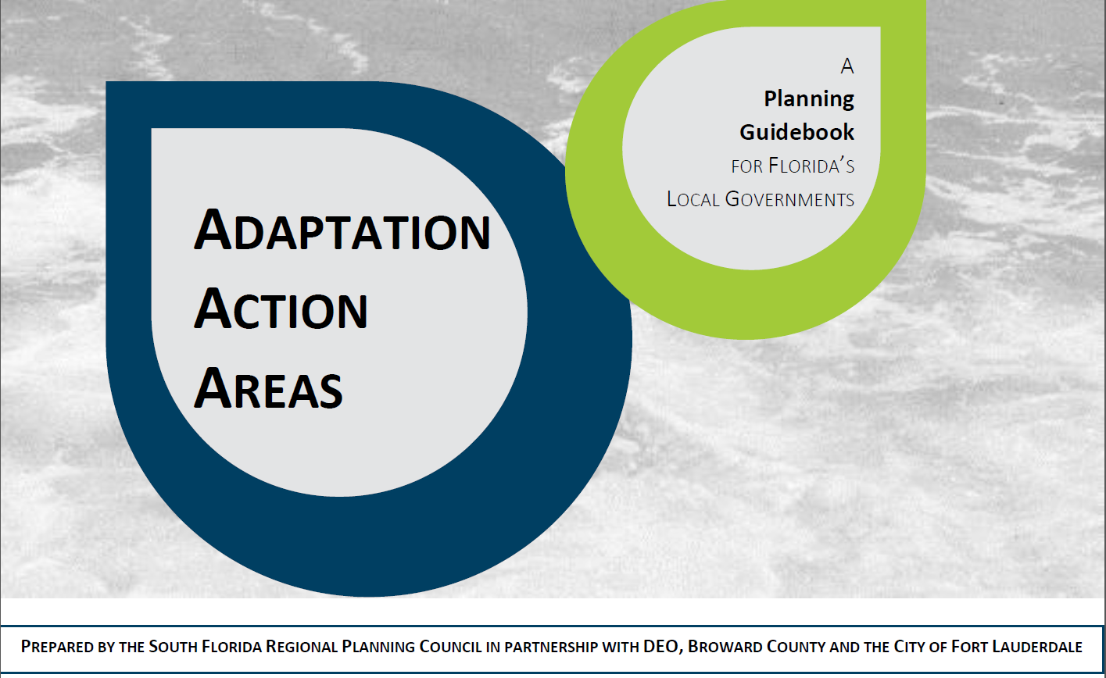
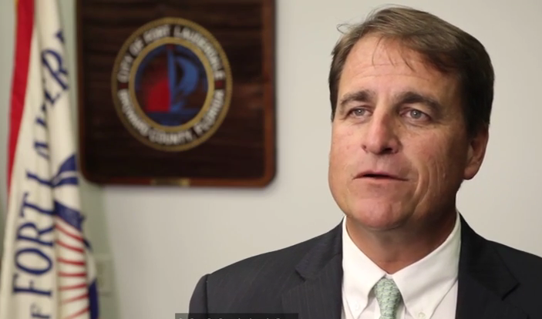
The South Florida Regional Council
compiled resources including:
Podcasts and Video,
Policy Options for Adaptive Planning for Rising Sea Levels,
Case Study: Fort Lauderdale, Broward County, FL
A Planning Guidebook for Florida’s Local Governments

Slide 16
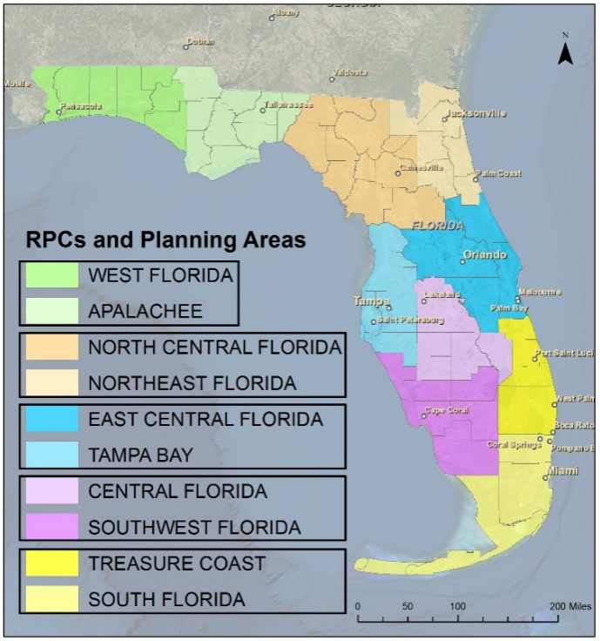
Project background
Trainers and Tools:
Building Coastal Flood Hazard Resiliency in Florida’s Regional Planning Council Communities

Slide 17
HAZARD ASSESSMENT TOOLS
CANVIS NOAA | SEA LEVEL RISE (SLR) VIEWER NOAA | Coastal Flood Exposure Mapper NOAA | SKETCH PLANNING TOOL UF GEOPLAN CENTER
is intended to elicit higher levels of stakeholder engagement, CanVis utilizes no data and modifies imagery to show potential inundation scenarios. | can facilitate stakeholder engagement, scoping and inventory, and assessment and analysis, SLR Viewer offers an online interactive platform in map format to display a variety of sealevel rise scenarios. | Helps start community discussions about hazard impacts with maps of your area that show people, places, and natural resources exposed to coastal flooding. Select a section to view maps showing flood hazards or different aspects of community exposure to those flood hazards. | visualizer and modelling software package intended to promote stakeholder engagement, scoping/ inventory, assessment/analysis, and planning, the Geoplan Sketch Planning Tool offers a variety of sea-level rise analyses related to transportation

Slide 18
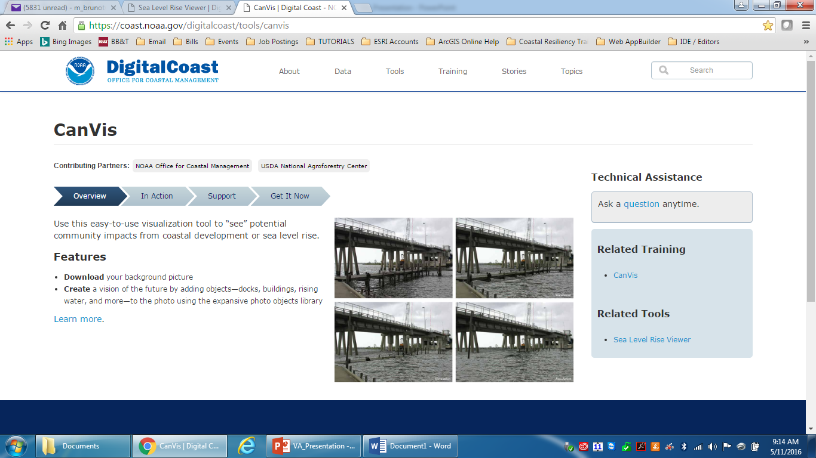
CANVIS
Developed by NOAA Office for Coastal Management
coast.noaa.gov/digitalcoast/tools/canvis

Slide 19
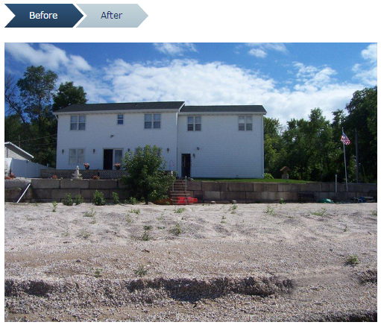
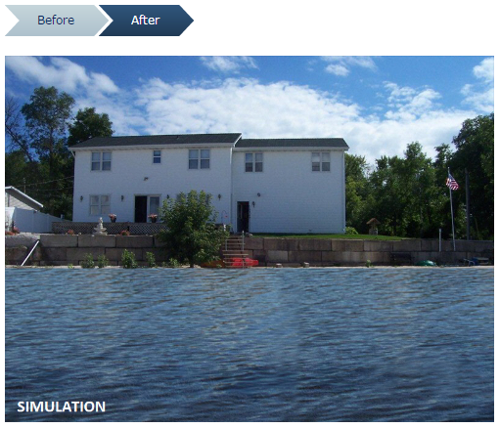
CANVIS
Developed by NOAA Office for Coastal Management
coast.noaa.gov/digitalcoast/tools/canvis

Slide 20
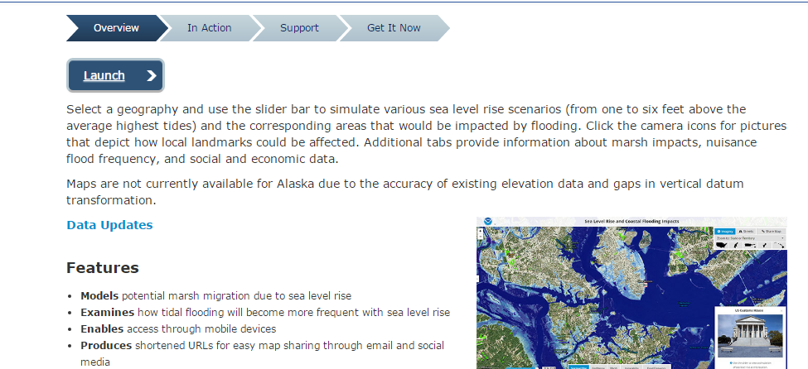

Sea level rise viewer
Developed by NOAA Office for Coastal Management
coast.noaa.gov/digitalcoast/tools/slr/

Slide 21
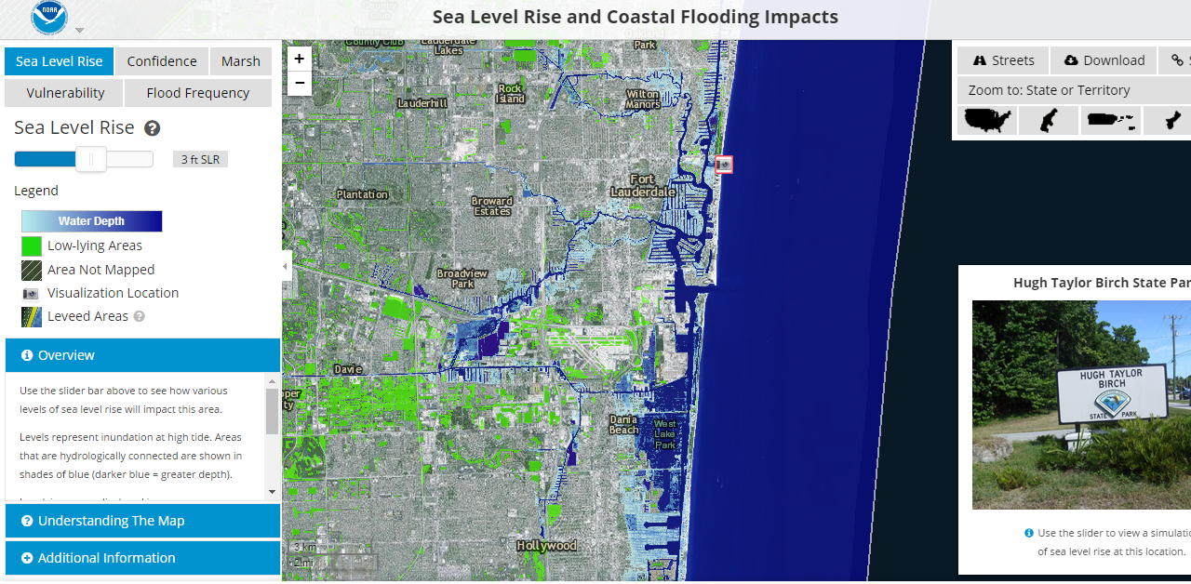

Slide 22
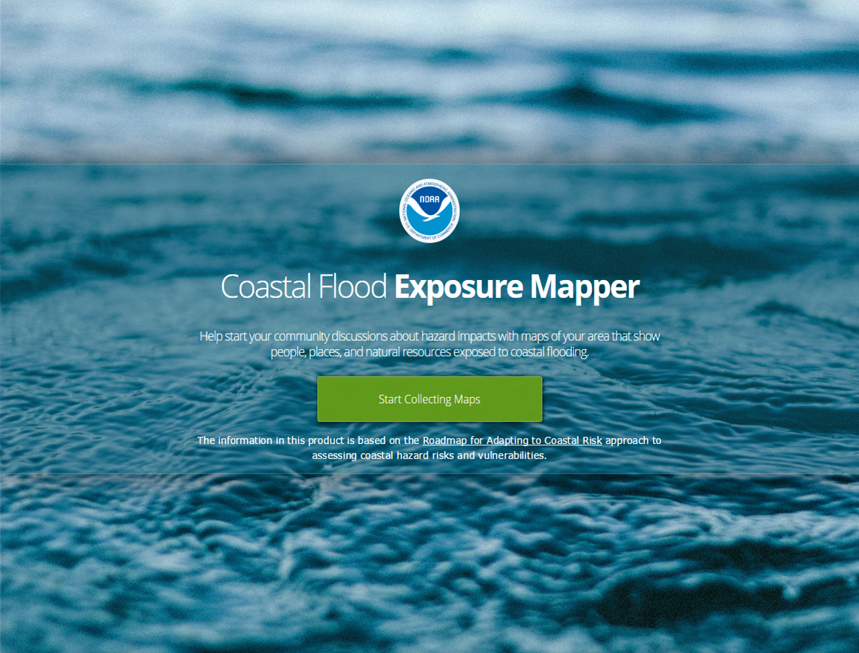
Coastal Flood Exposure Mapper
Developed by NOAA Office for Coastal Management
The information in this product is based on the Roadmap for Adapting to Coastal Risk
www.coast.noaa.gov/digitalcoast/tools/flood-exposure
Notes:
So, how do you know if your coastal community is exposed to flood hazards and could be at risk of damaging impacts from these hazards?
NOAA developed a new product recently called the Coastal Flood Exposure Mapper that was designed to help coastal communities visualize their exposure to flood hazards and start conversations around their risks and vulnerabilities and how they are going to reduce those risks. The product is currently available for coastal counties along the east coast and gulf of Mexico.
The information in this product is based on the Roadmap for Adapting to Coastal Risk approach to assessing coastal hazard risks and vulnerabilities.
Evolved from Experience
Guidance for Risk and Vulnerability Assessment
Approach Provides Framework for R & V Process
Principles: Community-based, Diverse Stakeholder Group, Participatory Process, Engagement with Maps and Data, Planning Integration
Webinar Delivery and Live Workshops - kick starter
Need for Maps

Slide 23
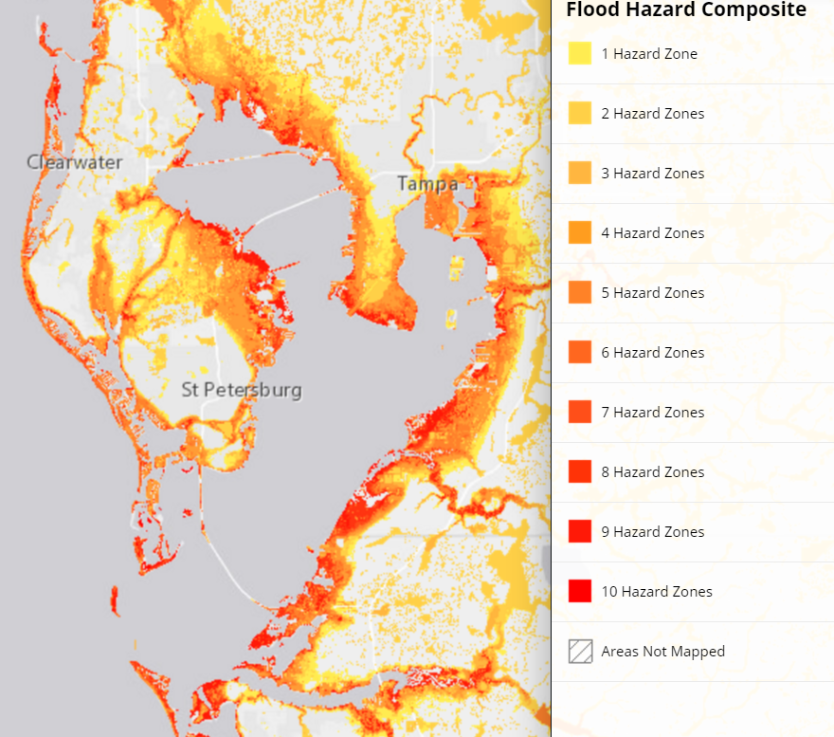
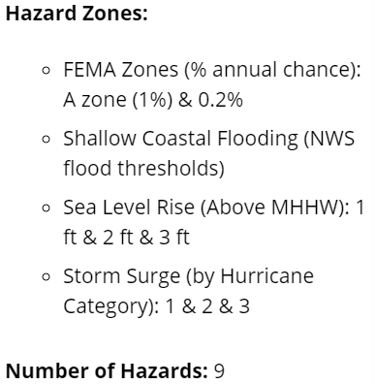
Coastal Flood Exposure mapper
NOAA
Notes:
Help start your community discussions about hazard impacts with maps of your area that show people, places, and natural resources exposed to coastal flooding.
These visualizers can facilitate stakeholder engagement, scoping and inventory, and assessment and analysis, The tools offer an online interactive platform in map format to display a variety of sea-level rise scenarios, storm surge, flood zones, and more!
Community infrastructure, including roads, bridges, and water and sewer systems, can be damaged by coastal flooding. Communities should first assess infrastructure vulnerabilities and associated environmental and economic issues to determine what steps are needed to protect these assets.

Slide 24
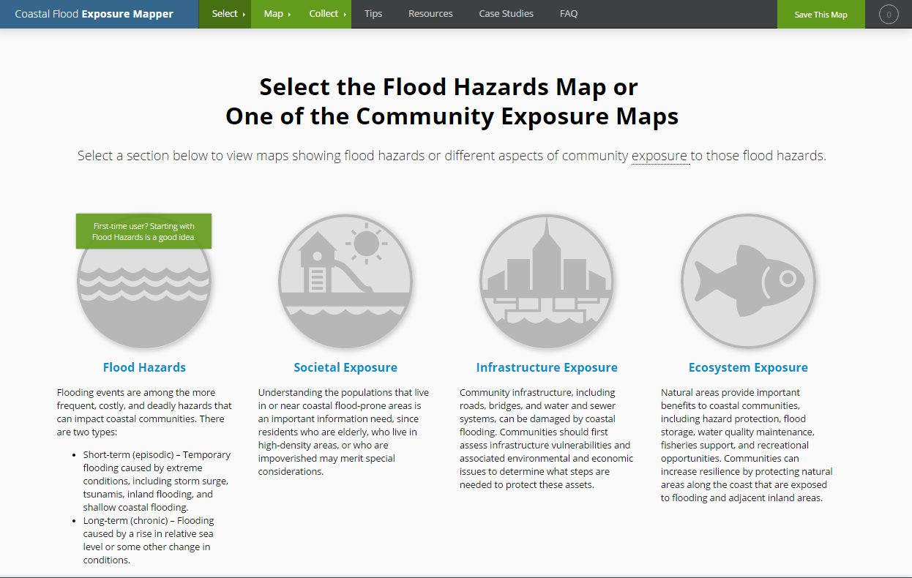
www.coast.noaa.gov/digitalcoast/tools/flood-exposure
Notes:
The product allows you to select maps showing either just coastal flood hazards or where societal, infrastructure, and ecosystem assets are exposed to coastal flood hazards for your location (currently by county, but you can also zoom and pan to set your extent if you want to get a more local or more regional look).
I’m going to give you a quick tour of what you’ll find in this product using screen grabs since we are without wifi (not sure if NC GIS conference will have wifi in the room, but back-up screen grabs would be important). I’m going to use ?? County, NC as the location for this example.
So, if I select just the Flood Hazards Map…

Slide 25
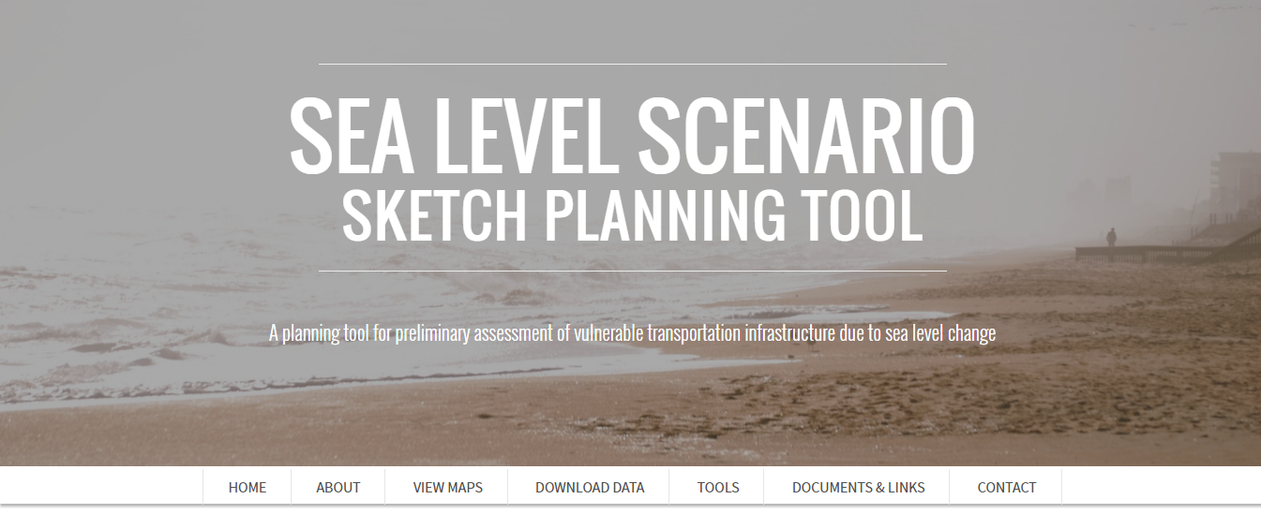
Sketch planning tool
Developed by the University of Florida GeoPlan Center
sls.geoplan.ufl.edu

Slide 26
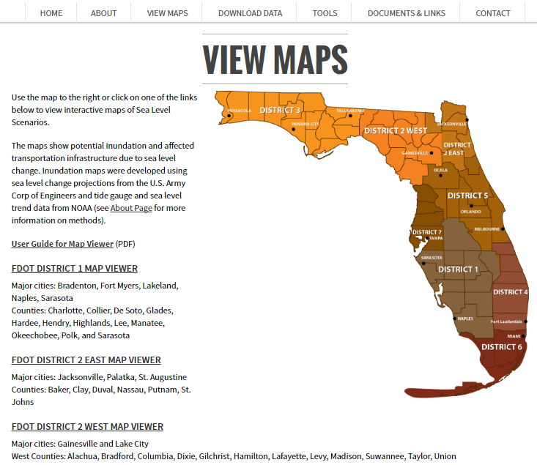
Sketch planning tool
INTERACTIVE MAPS

Slide 27
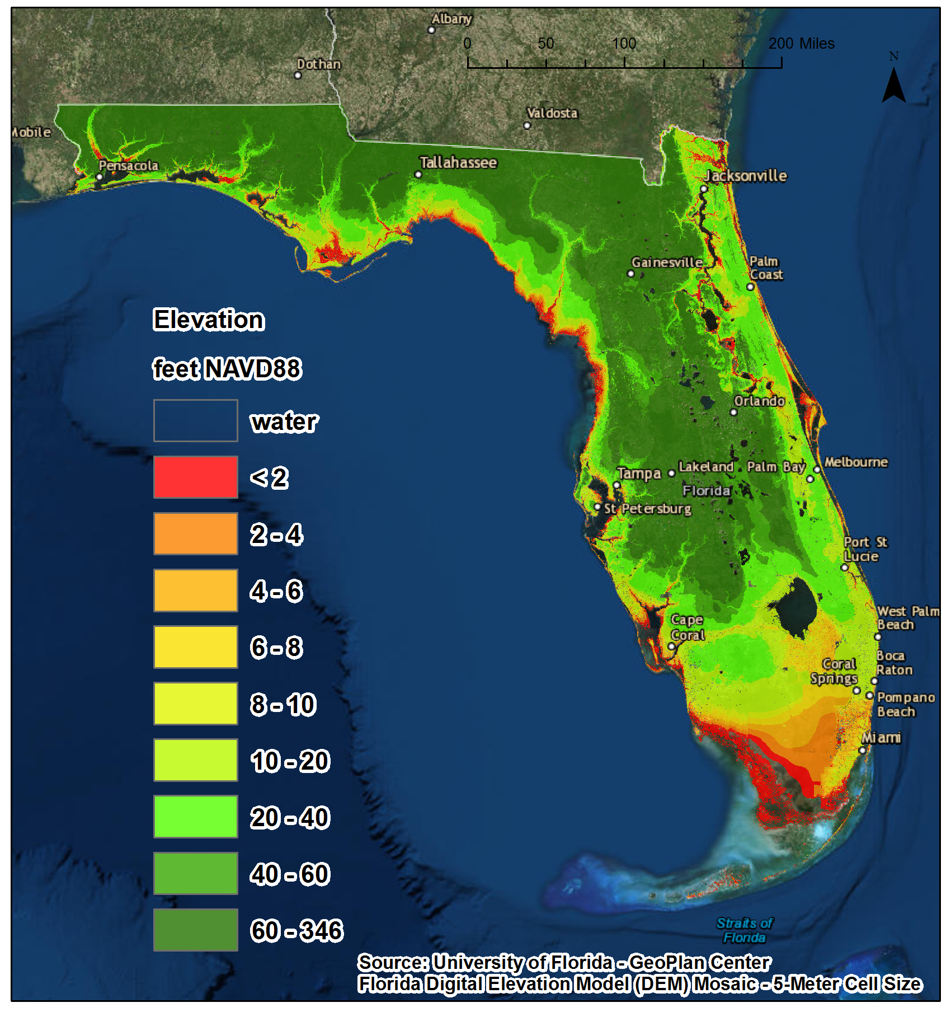
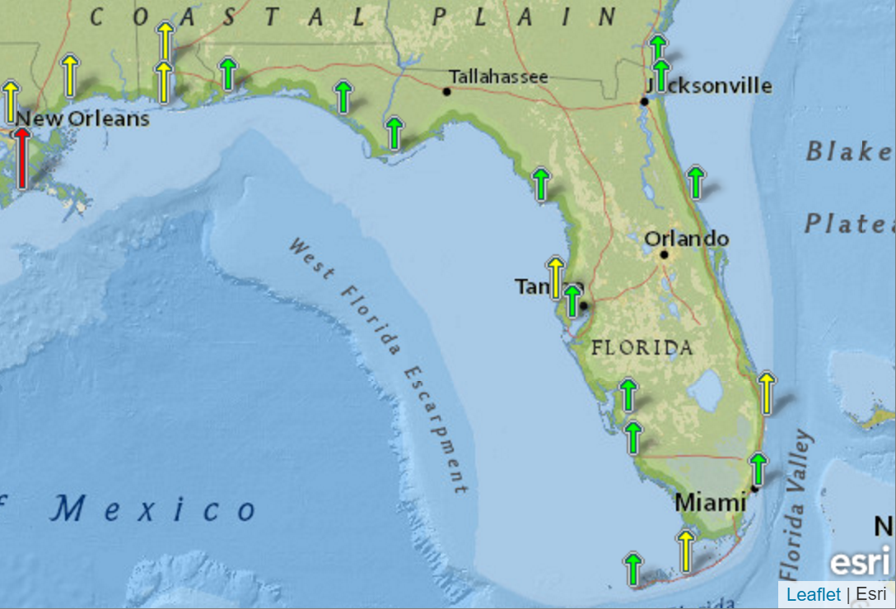
Assessment report of regional differences within Florida

Slide 28
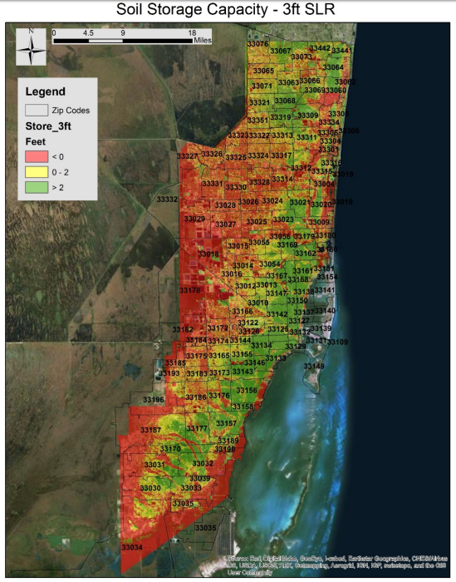
Impacts of SLR on Public Health
- Mapped zones most prone to environmental sea level rise impacts
- Described associated public health risks and
- Identified the region's socially, economically and medically vulnerable communities most susceptible to sea-level rise health effects.

Slide 29
SB 1094
Requires that local governments take steps to to eliminate inappropriate and unsafe development in the coastal areas when opportunities arise.
When undertaking redevelopment, include development and redevelopment principles, strategies, and engineering solutions that reduce the flood risk in coastal areas which results from high-tide events, storm surge, flash floods, stormwater runoff, and the related impacts of sea-level rise.
Notes:
Florida Statute section 163.3178(2)(f)1. now includes “sea-level rise” as one of the causes of flood risk that must be addressed in the “redevelopment principles, strategies, and engineering solutions” to reduce flood risk.

Slide 30
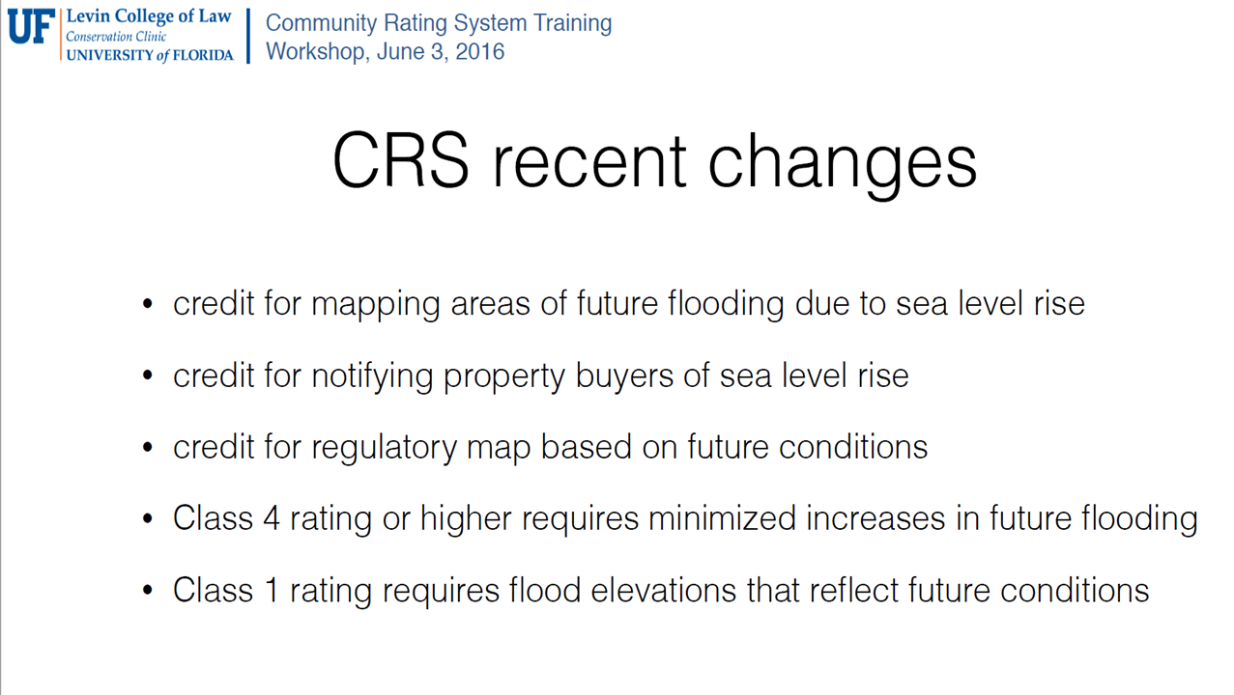
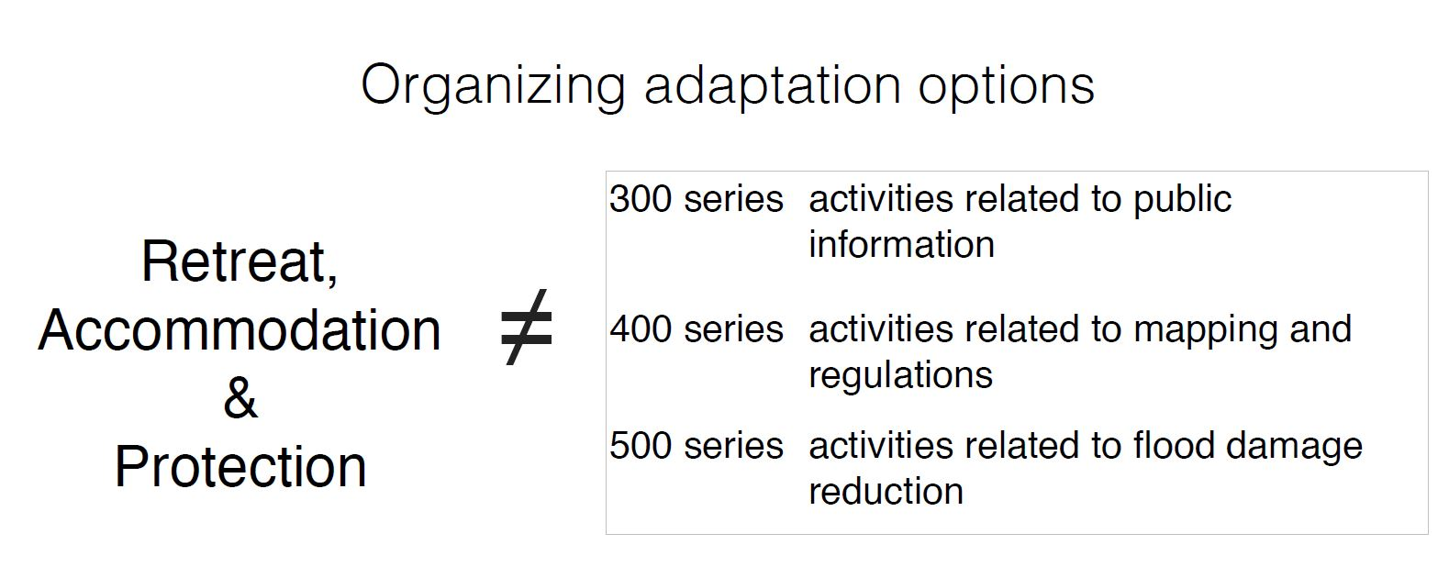
NFIP Community Rating System (CRS) credits lower flood insurance rates
NOAA’s Coastal Flood Exposure Mapper is particularly useful for Floodplain Management Planning (Activity 510), Element 512.a
Source: W. Thomas Hawkins, UF College of Law, 2016 http://www.tbrpc.org/onebay/obwg/060316/Hawkins_UF_CRS_ClimateAdapt_06032016.pdf

Slide 31
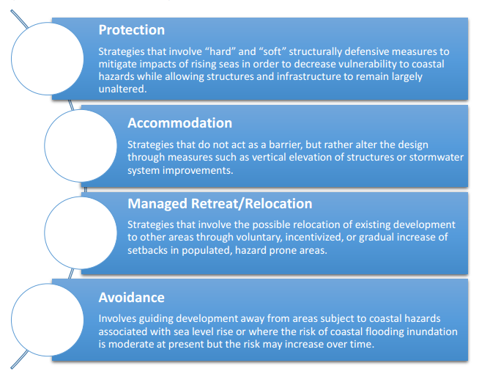
Solutions?

Slide 32
Effective Adaptation Strategies
1) land-use regulations & building codes
2) limits on insurance subsidies
3) redesign and retrofitting of structures
4) updates for drainage, flood control, and water supply infrastructure
5) increased coastal protection
CO-BENEFITS!
Notes:
Danger of “Wait-and-see”
1) land-use regulations that limit development in high risk areas
2) limits on insurance subsidies for coastal properties so that rates reflect true risk
3) redesign and retrofitting of structures to increase their resilience to inundation and storm surge
4) updates for drainage, flood control, and water supply infrastructure
5) increased coastal protection through buffers such as living shorelines

