Slide 1

Florida Framework for Affordable Housing
Prepared by Jaimie Ross
President/CEO, Florida Housing Coalition
for
FLORIDA REGIONAL COUNCILS ASSOCIATION EXECUTIVE DIRECTORS ADVISORY COMMITTEE
March 11, 2016

Slide 2
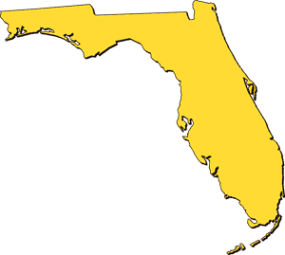
State Law
Every jurisdiction in Florida has the obligation to provide for housing its entire current and anticipated population, including the most vulnerable, such as those with special needs and farmworkers.
Chapter 163.3177 (6)(f)

Slide 3
The Housing Element of the Comprehensive Plan
The Housing Element requirement does not mean that local governments have to build all this housing themselves….
It does mean that local government should use its police powers (to carry out laws for the health and safety of its residents), its land use authority, and its compliance with the spirit and intent of fair housing and affordable housing laws to create an environment in which affordable housing will be provided by the private sector.

Slide 4

How is Housing Made Affordable?
Government Resources
Land Use Planning/Permitting
Zoning codes can Break or Make affordable housing.
Financing/ Long Term Affordability

Slide 5
Examples that Promote
Affordable Housing
Inclusionary housing policies and linkage fees
Flexibility--Permitting smaller units, mixed use properties, avoiding regressive impact fees
Permitting ADUs in all residential zones
Supporting mission- based organizations; CLTs
Political will is key: Embracing affordable housing as a community asset

Slide 6
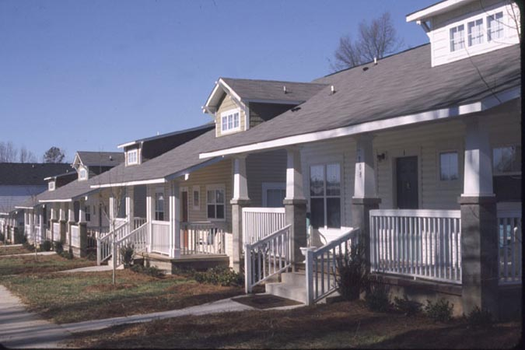
The Bungalows
Davidson, NC

Slide 7
The Bungalows
Davidson, NC

Slide 8
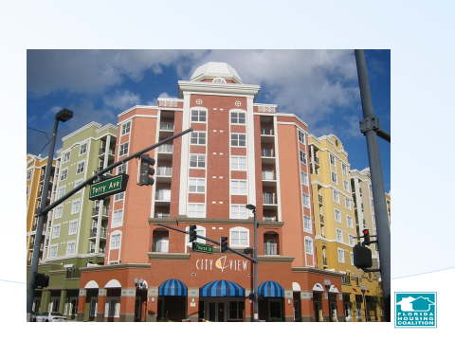
Mixed Use and Mixed Income

Slide 9
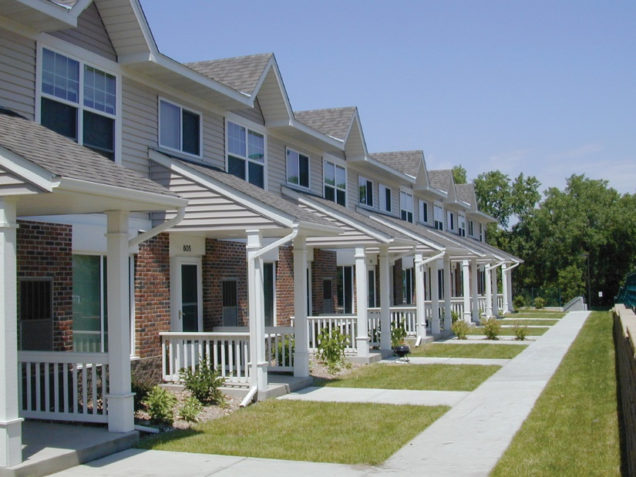
Attached Housing

Slide 10
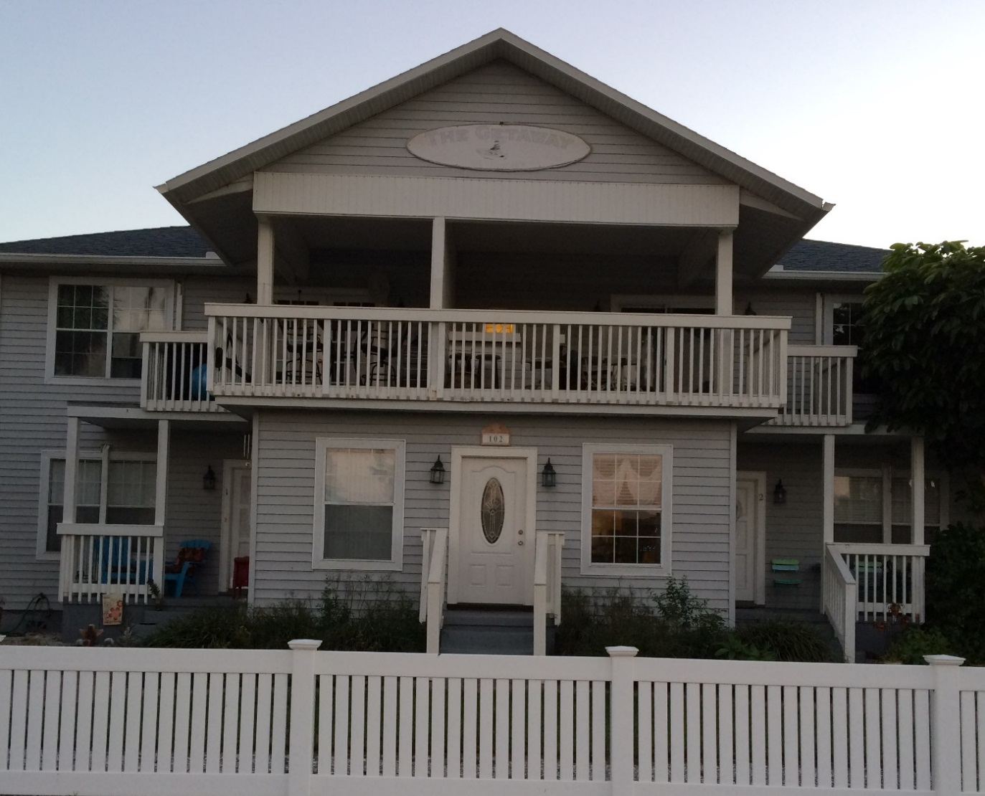
Triplex architecturally similar to single-family homes on the street

Slide 11
Accessory Dwelling Units
Florida State Statute 163.31771-
(1) …. This shortage of affordable rentals constitutes a threat to the health, safety, and welfare of the residents of the state.
Therefore, the Legislature finds that it serves an important public purpose to encourage the permitting of accessory dwelling units in single-family residential areas in order to increase the availability of affordable rentals for extremely-low-income, very-low-income, low-income, or moderate-income persons.

Slide 12
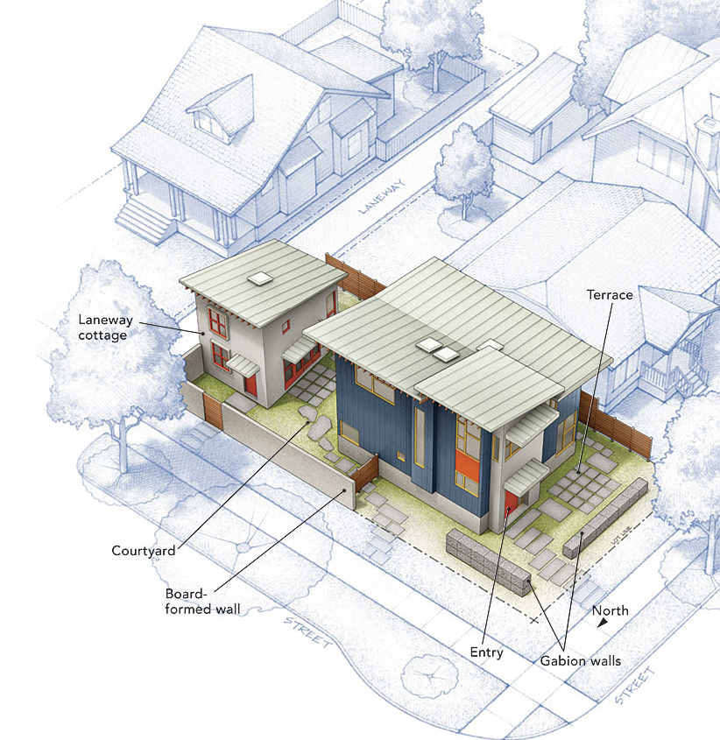
Accessory Dwelling Units

Slide 13
Land Use Planning that Promotes Affordable Housing
Mixed Use and Mixed Income Housing close to employment and services (encouraged by state statute 163.3177(6) (f))
Allowing accessory dwelling units in all residential zones (encouraged by state statute 163.31771
Inclusionary housing policies (specifically permitted by Florida Statute 125. 01055)

Slide 14
Supported in State Statute – Inclusionary Zoning
Section 125.01055 (166.0415) Affordable Housing.–Notwithstanding any other provision of law, a county (municipality) may adopt and maintain in effect any law, ordinance, rule, or other measure that is adopted for the purpose of increasing the supply of affordable housing using land use mechanisms such as inclusionary housing ordinances.

Slide 15
Role of Local Government
To promote public health, safety, and welfare
To be a good steward of the land for current and future generations
To balance private property rights with public interests

Slide 16
Inclusionary Housing
A local land use regulation (planning tool) that requires the market rate housing developer to include a percentage of affordable housing within the market rate development
Typically, to get units into the very low income range, public subsidy is also needed- good example of where planning department and housing department (finance)can work together

Slide 17
Principle of New Urbanism
Yet, with the exception of HOPE VI redevelopments, virtually none of the more than 55 new urbanism developments in Florida provide affordable units
Florida is the “poster child” for the need to require that New Urbanism communities include long term or permanent affordable housing

Slide 18

Seaside, Florida
The “employee cottages”- would become homes for millionaires

Slide 19
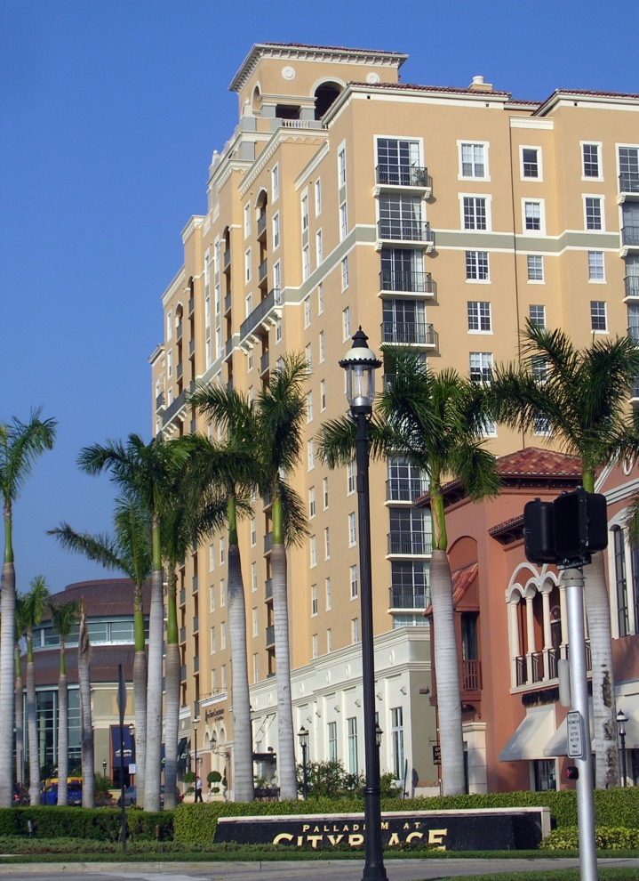
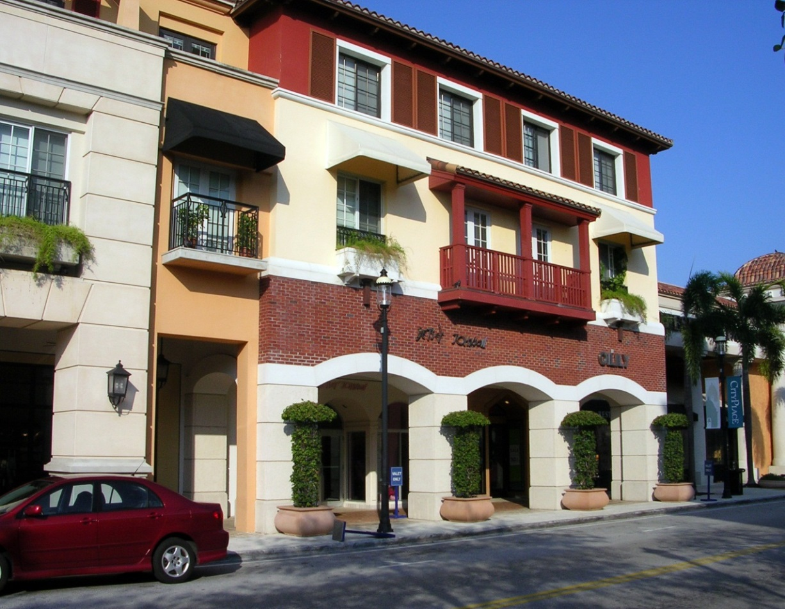
City Place, West Palm Beach

Slide 20
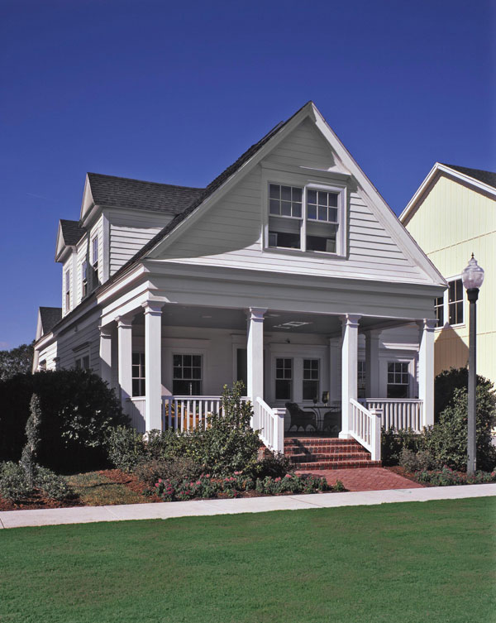
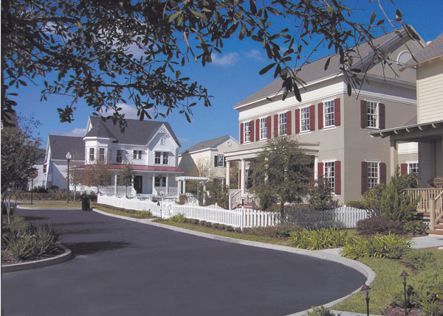
Baldwin Park, Orlando
(former Navy Base)
When there is no inclusionary requirement, we find
that new urbanism developments typically fail to include
homes for low income populations.

Slide 21
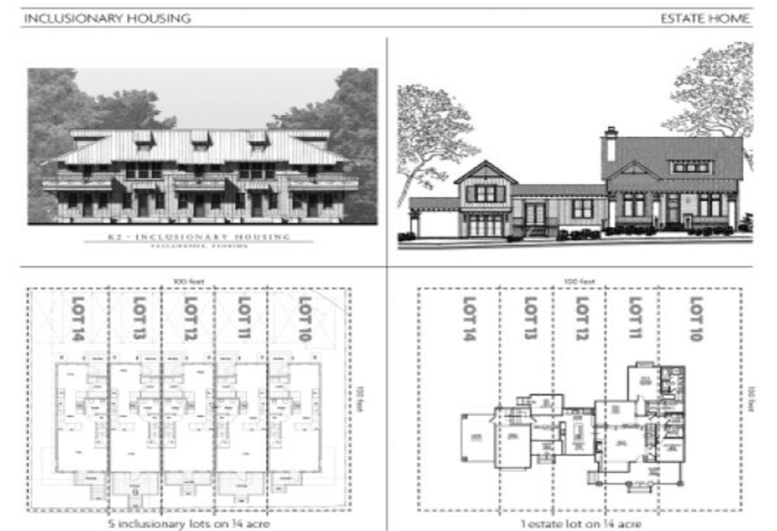
Inclusionary Housing-flexibility

Slide 22
Inclusionary Housing Best Practices
Needs to have long term or perpetual affordability
Should create as little burden on market rate developer as possible- local government should provide income compliance assistance
Use a CLT to provide pipeline of homebuyers or renters as well as to provide stewardship

Slide 23
Community Land Trusts
Separates the land from the building
Mission based nonprofit retains ownership of the land
99 year ground lease to homeowner with right to repurchase; can also be used for rental
Retains affordable housing and the public subsidy in perpetuity

Slide 24

Micro Housing/Tiny Homes
Pocket Neighborhood Zoning

Slide 25
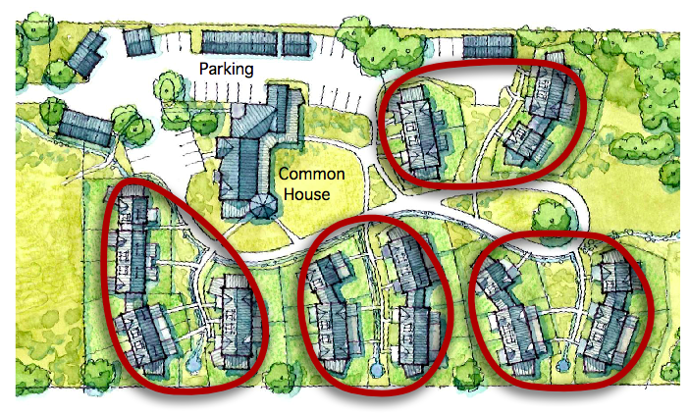
Pocket Neighborhood Accommodate Tiny Homes and Co-housing

Slide 26
Linkage Fee Ordinances
Complementary to an Inclusionary ordinance
Collects $ from commercial development to be placed in housing trust fund for others to use to produce/preserve affordable housing
Ordinance needs to address who pays, how much, and what the funds will be used for
Akin to an impact fee (ideal to have nexus study)

Slide 27
Financing & Affordability
Subsidy to the developer for construction or rehabilitation of housing which will be sold at an affordable price or rented at an affordable rent
The private sector builds and manages affordable housing
Subsidy agreements require long term affordability and compliance monitoring for rental
For affordable homeownership, typically recapture agreements, some moving toward permanent affordability

Slide 28
Low Income Housing Tax Credits
(LIHTC)
Most important financing for affordable housing apartments- Program of US Treasury
Housing Credits (HC) administered by Florida Housing Finance Corporation (FHFC)
Competitive applications
Developers come to local government for contributions
Apartments are monitored and affordable long term

Slide 29
Florida’s Dedicated Revenue Source
Housing Element Requirement was viewed as “unfunded mandate”
Florida adopted the William E. Sadowski Affordable Housing Act in 1992.
Increased the documentary stamp tax and dedicated to state and local housing trust funds.
Approximately 70% goes to LGTF: SHIP- distributed on population based formula.
Approximately 30% goes to SHTF: SAIL (State Apartment Incentive Loan program) and other programs.

Slide 30


Sadowski Coalition
30 Statewide Organizations from business sector to faith based organizations
One Message- Use all the housing trust fund monies for Florida’s housing programs
SHIP is 70% of the housing trust fund money- 65% must be used for homeownership activities

Slide 31
Fair Housing Laws
Housing choice is key concept.
Connection between Fair Housing and Affordable Housing.
Low wealth families disproportionately people of color- race and ethnicity are protected classes in Fair Housing Act, as is familial status (children in the family) and disability.
Exclusionary land use practices may create disparate impact liability.

Slide 32
Florida Fair Housing Act
CH. 760.26
Additional protection for affordable housing development.
Unlawful to discriminate in land use decisions based on the financing of the development.
In plain English: Local government is not permitted to deny development approval of an apartment complex that is affordable (tax credit development, for example) if it would have approved a market rate complex.

Slide 33
More Tools for the Continuum of Housing Needs
F.S. §125.379 Surplus Lands for Affordable Housing. Mandates local governments prepare an inventory of properties owned fee simple by the municipality and identify those properties that may be eligible for affordable housing development
Review How Impact Fees are assessed- based on unit or square foot? Same fee for 2,500 sq. ft. as for 500 sq.ft?
Notes:
Input county statute

Slide 34

“Takeaways”
Local government has a robust role in producing and preserving affordable housing in Florida. The two main functions are (1) Planning; and (2) Financing
Local Government is not in the business of building affordable housing, but it does have an obligation to ensure that it does whatever it can to help the private sector to meet the need.
We have an excellent framework for providing affordable housing in Florida- the work to do now is to support planning staff and elected officials with information, best practices, and the importance of political will.

Slide 35
Thank you
The Florida Housing Coalition is a statewide nonprofit that provides training and technical assistance to government and their nonprofit partners through the Catalyst Program for Training and Technical Assistance administered by the FHFC and Homeless Training and TA under contract with DEO.
Contact ross@flhousing.org for more information. We can help you!

